Slide 2
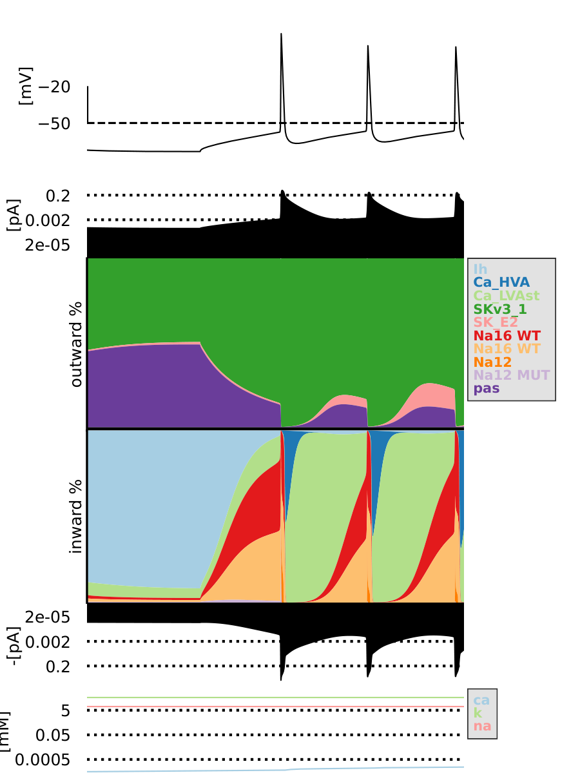
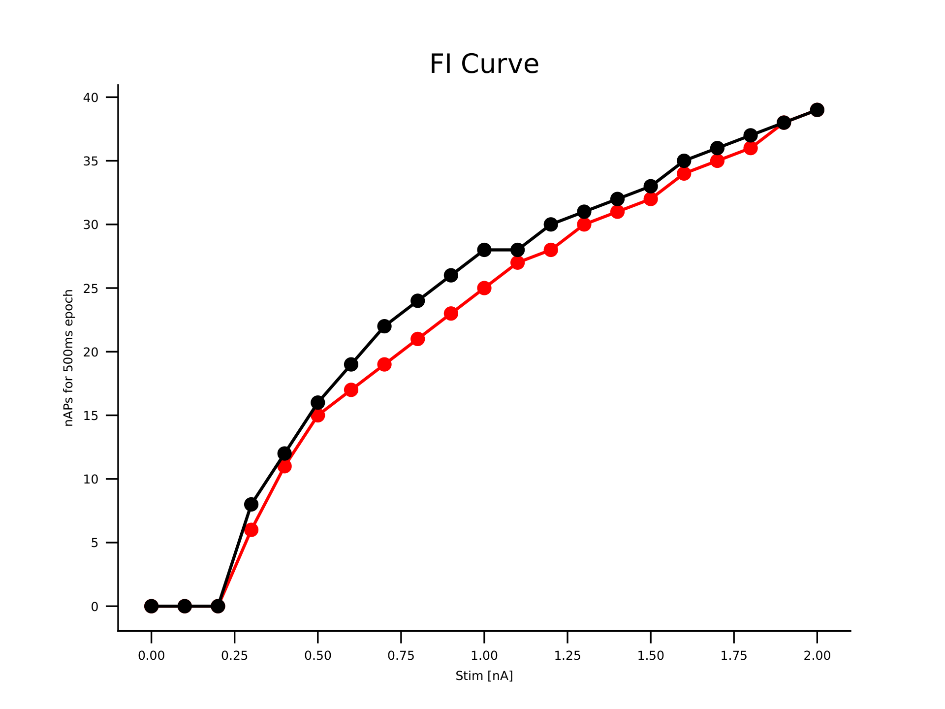
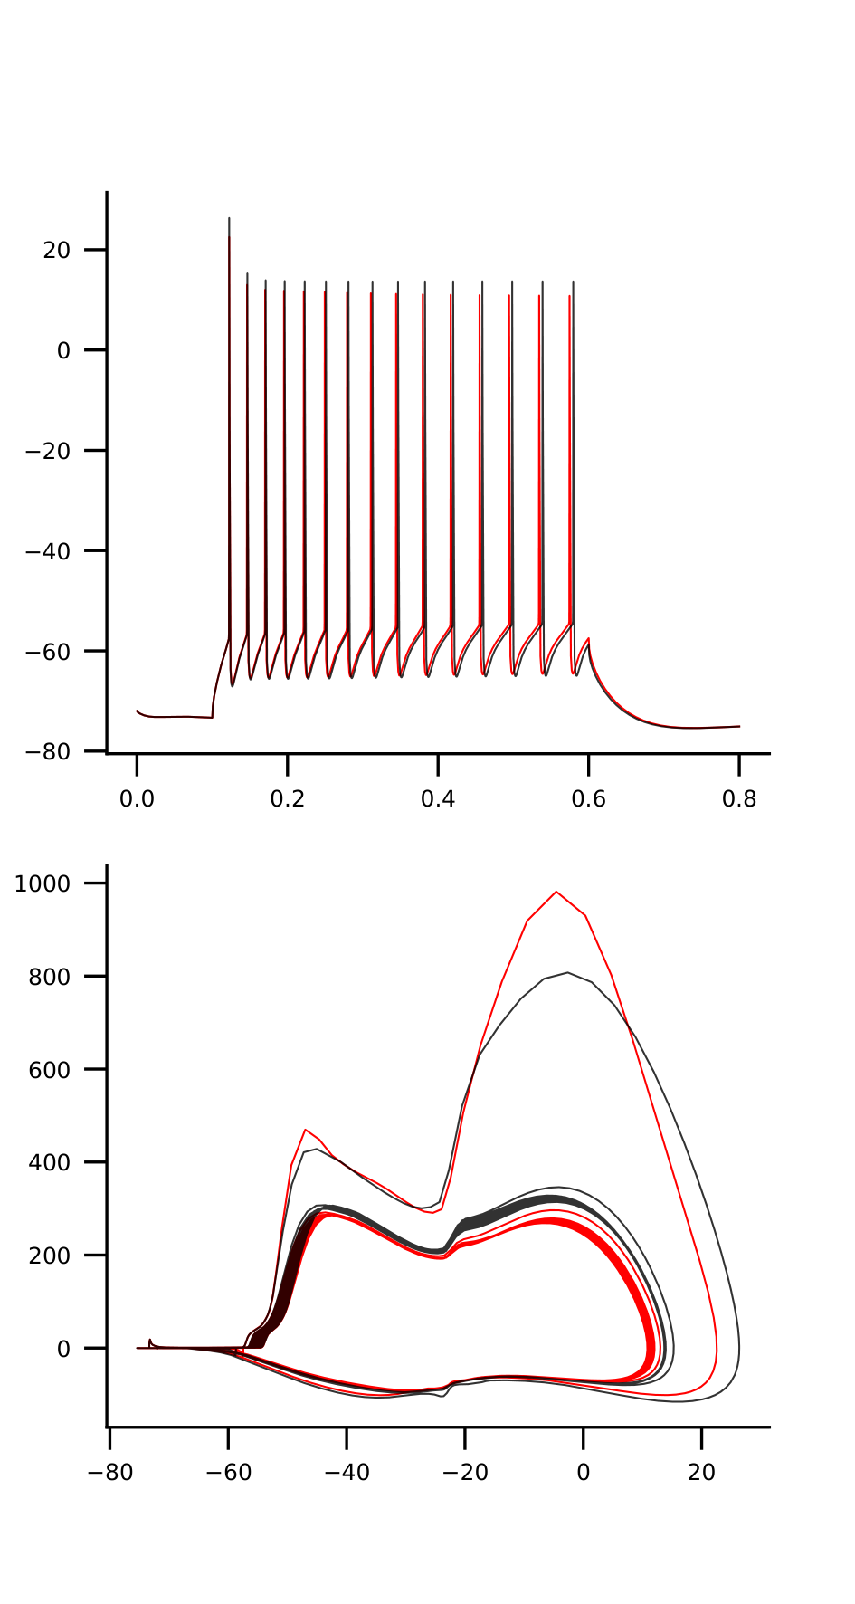
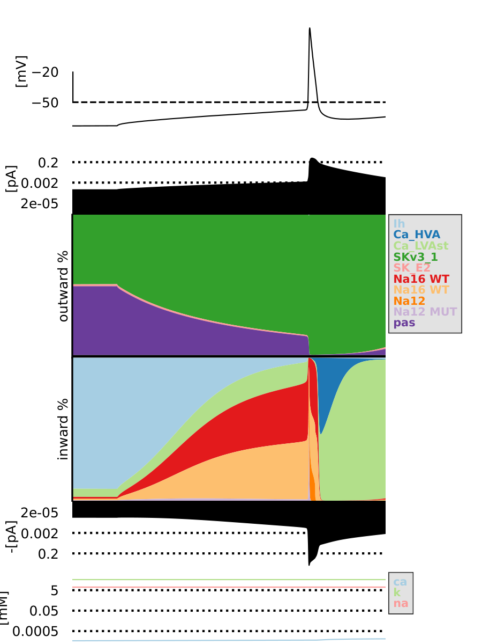
mut2_2_na12-2.5_na16-1.0

Slide 3
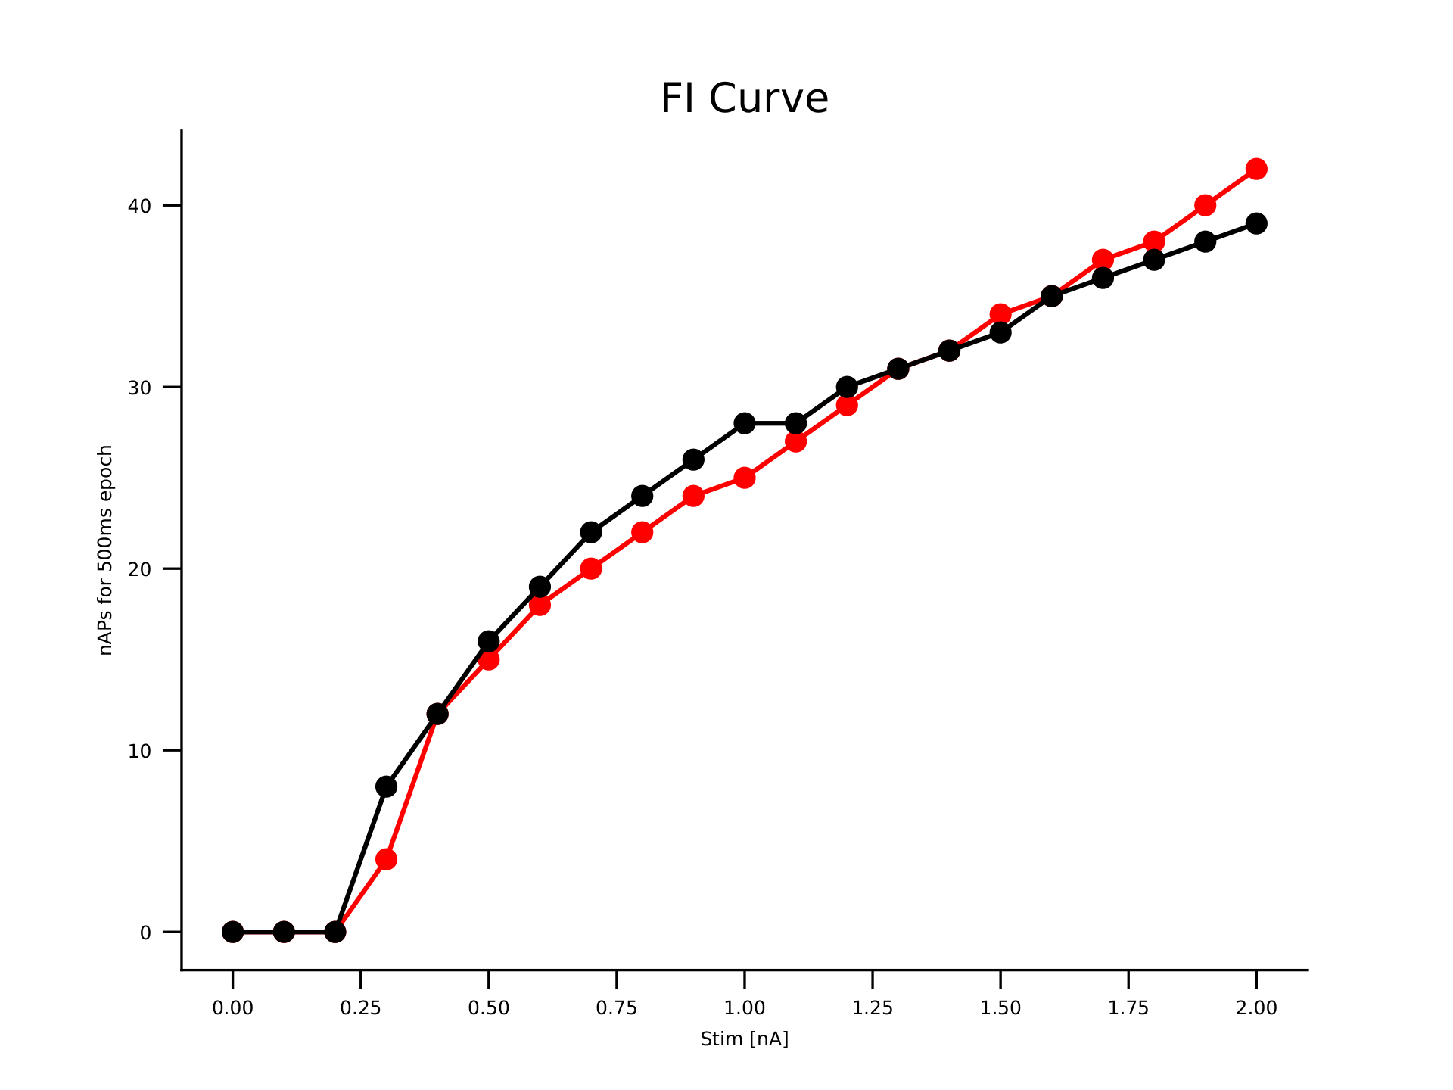
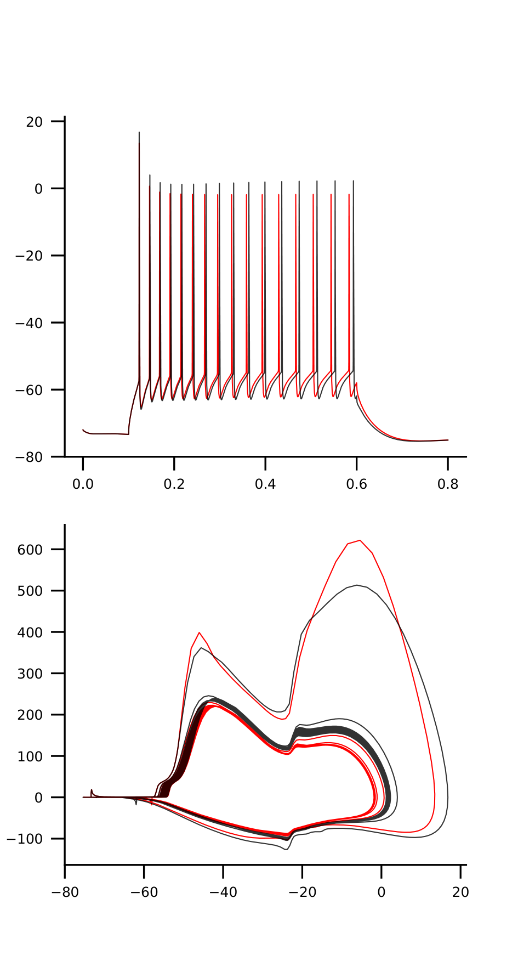
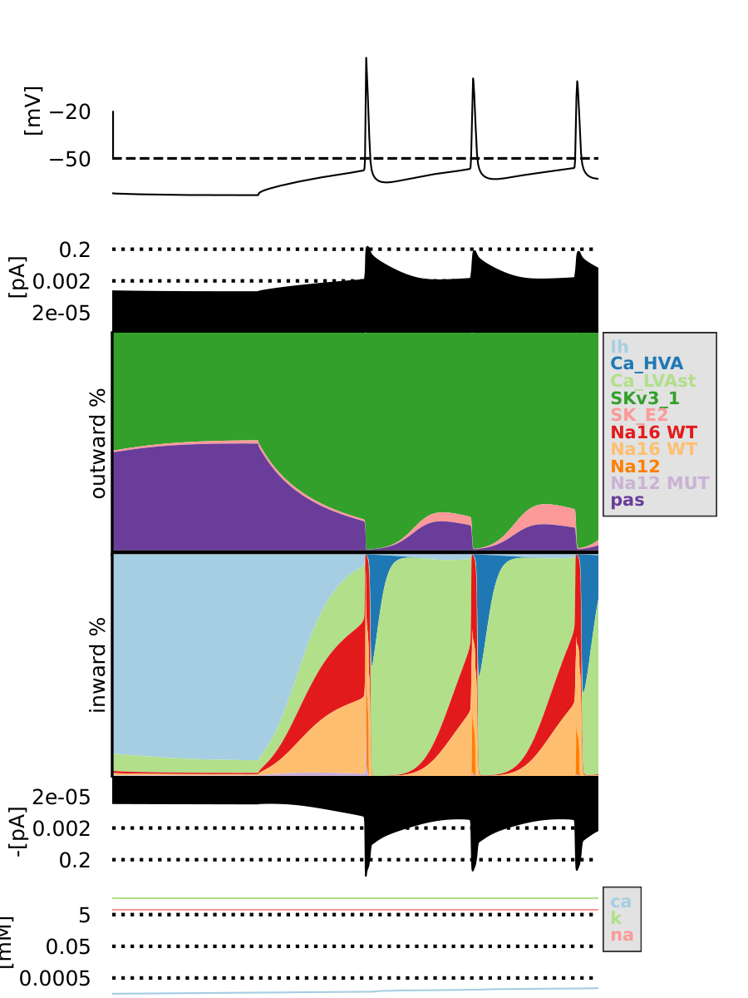
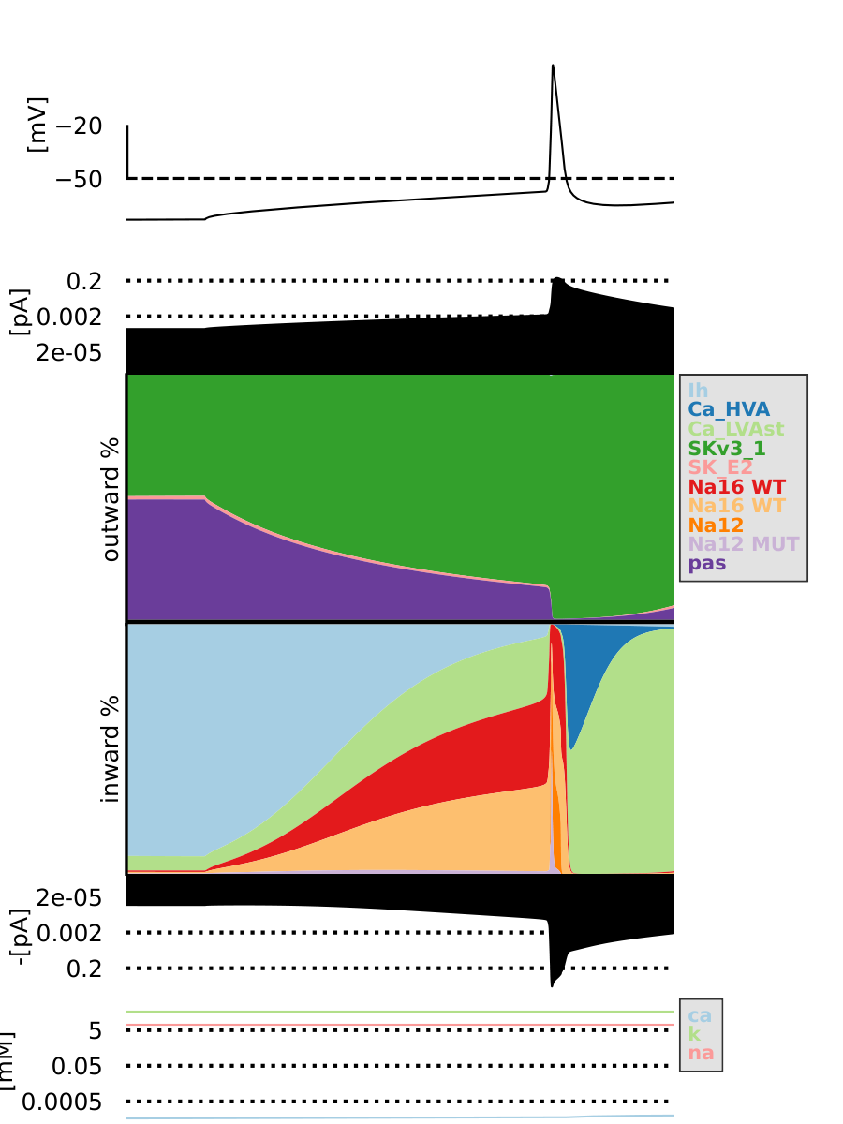
mut2_2_na12-1.75_na16-0.5

Slide 4
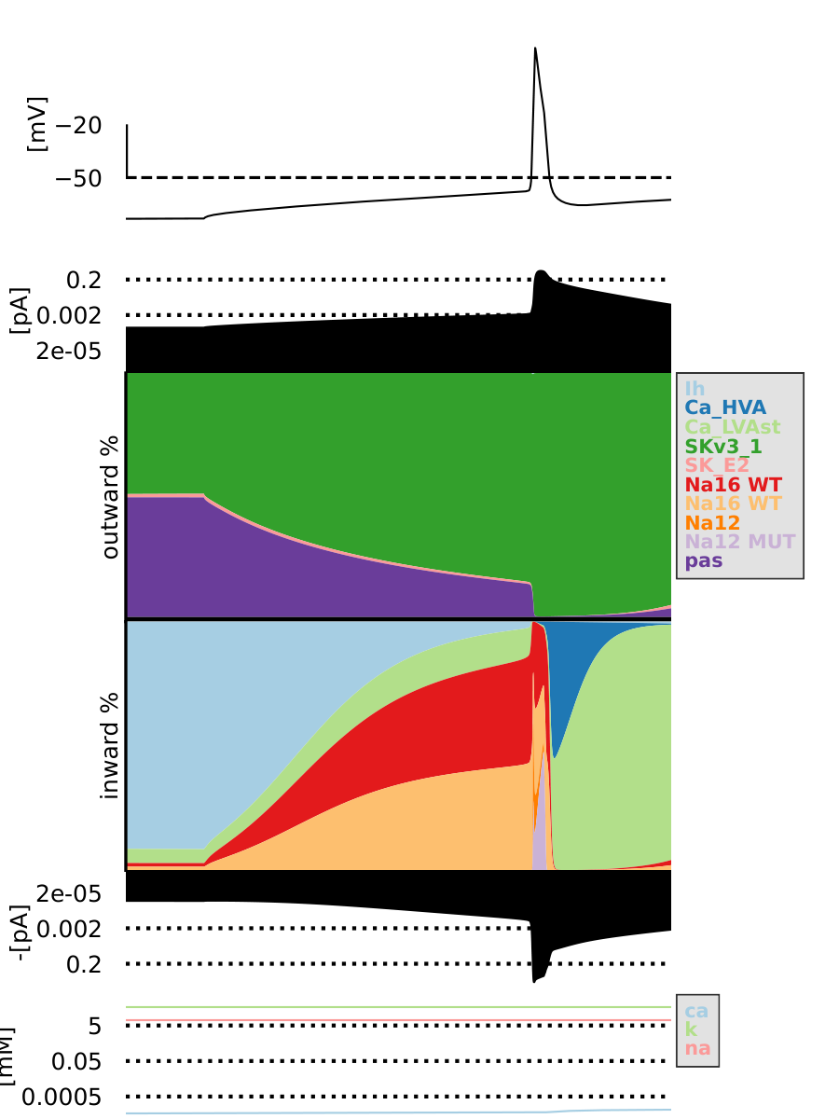
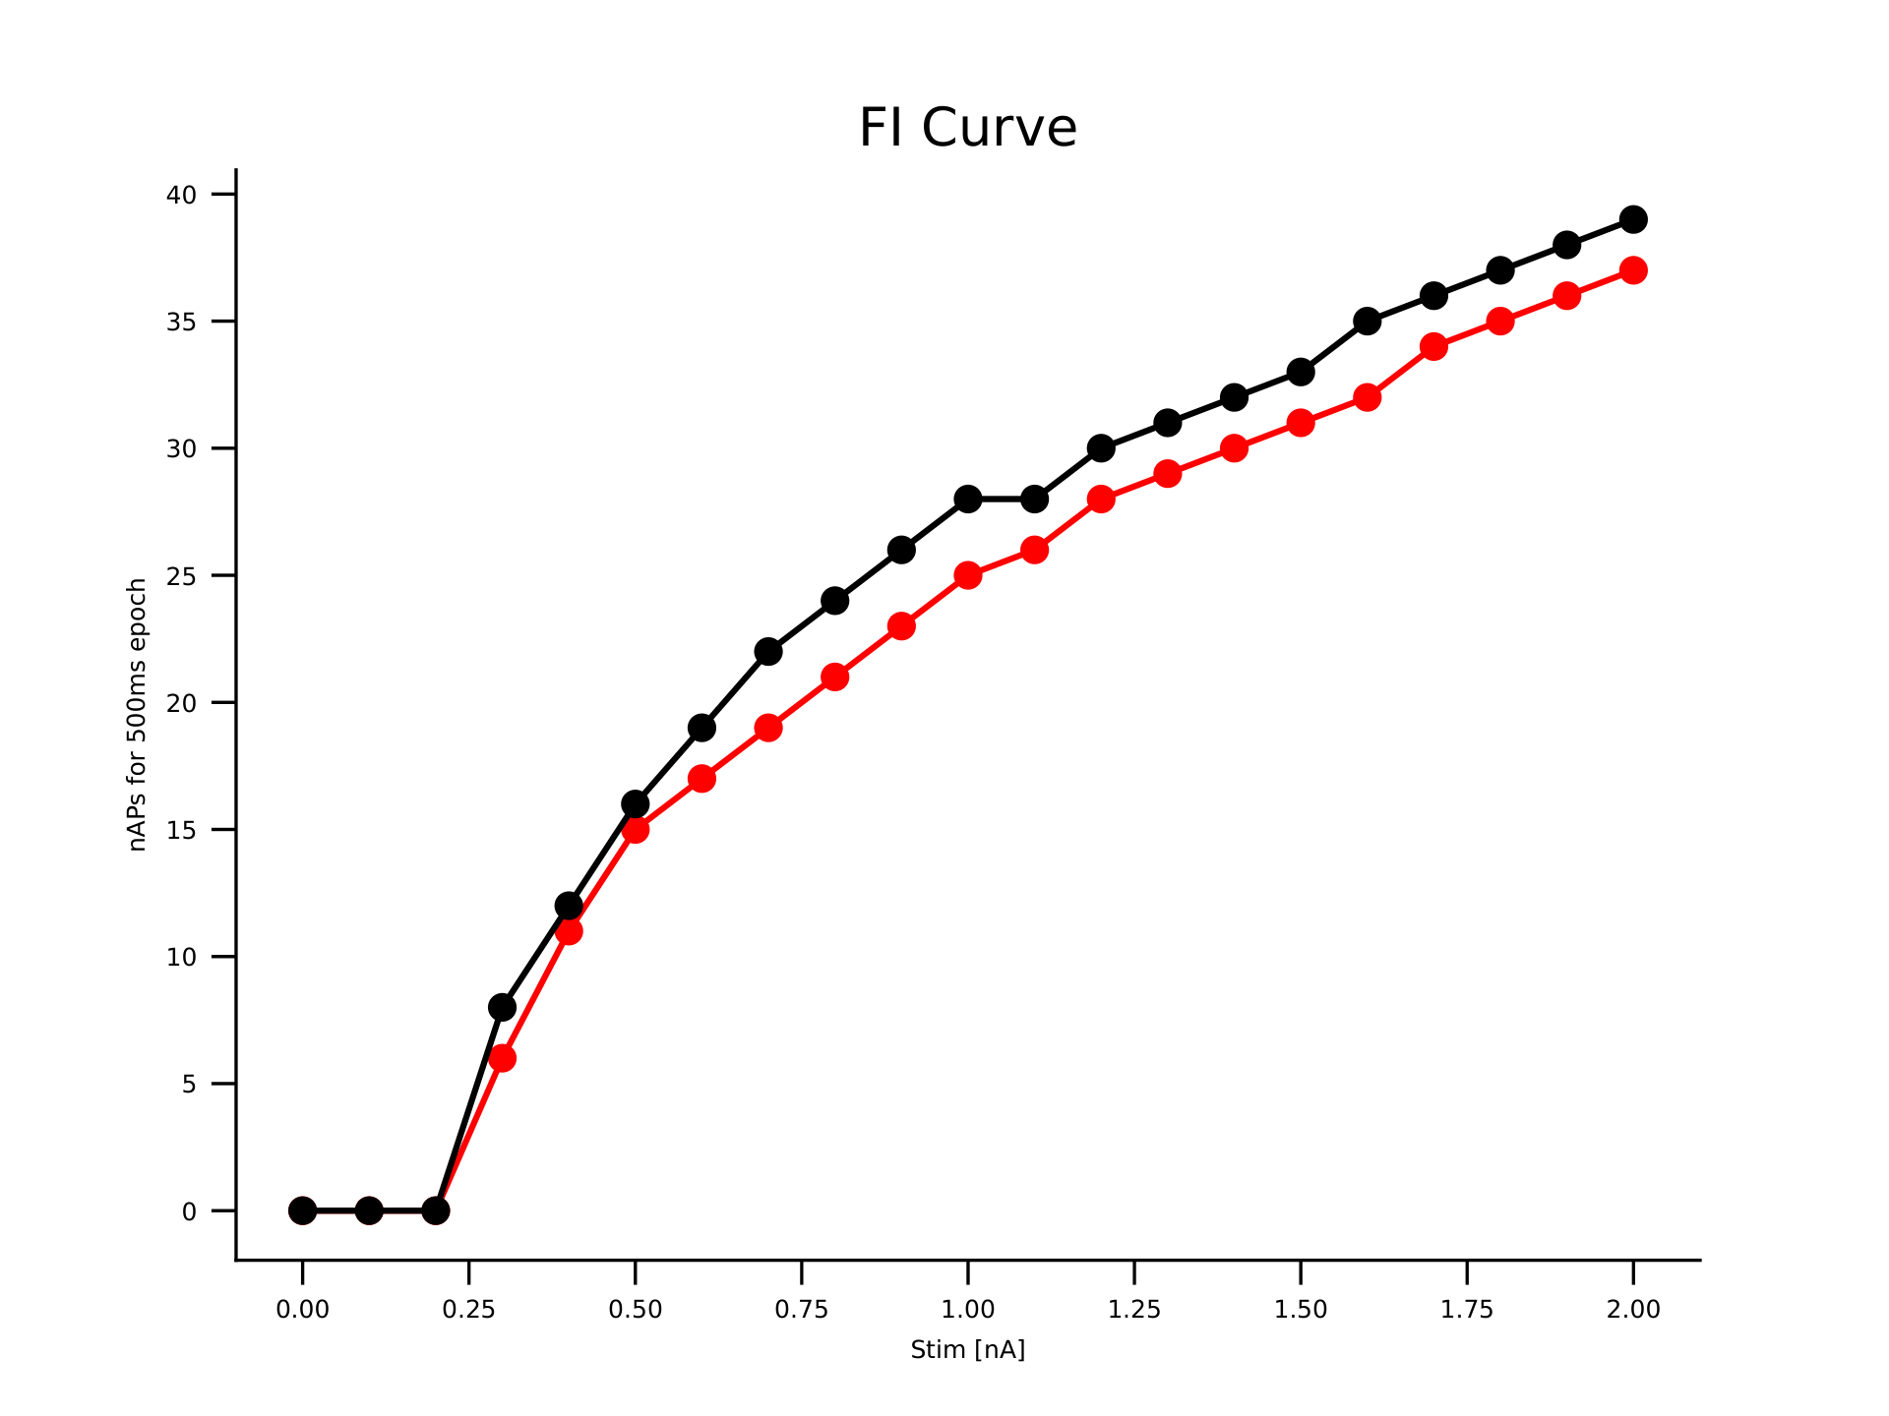
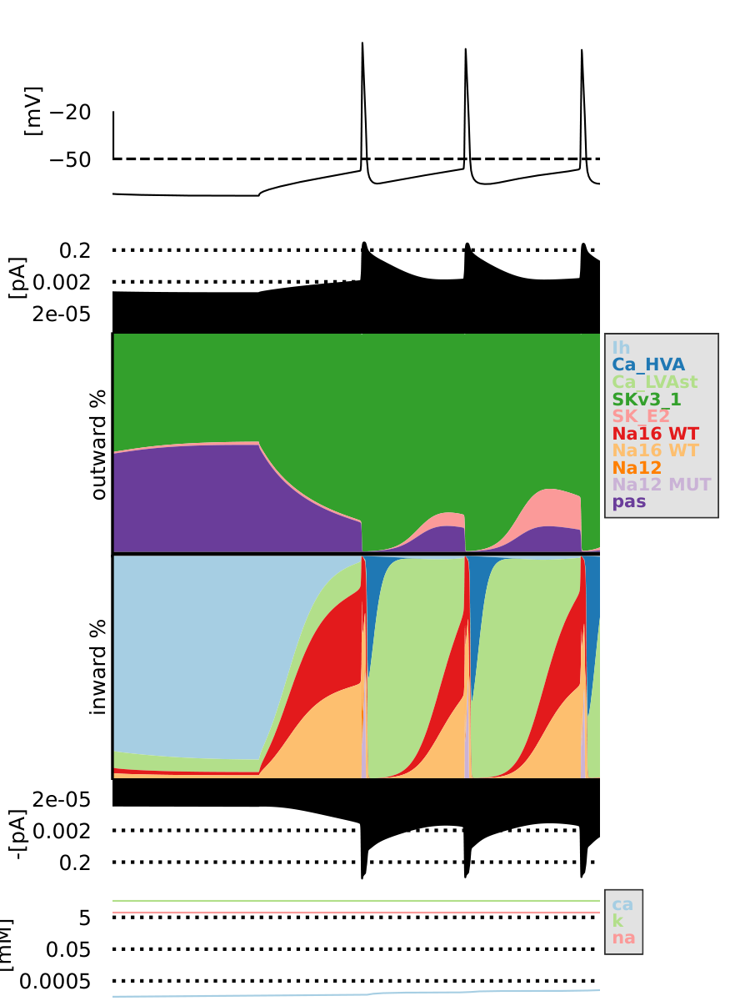
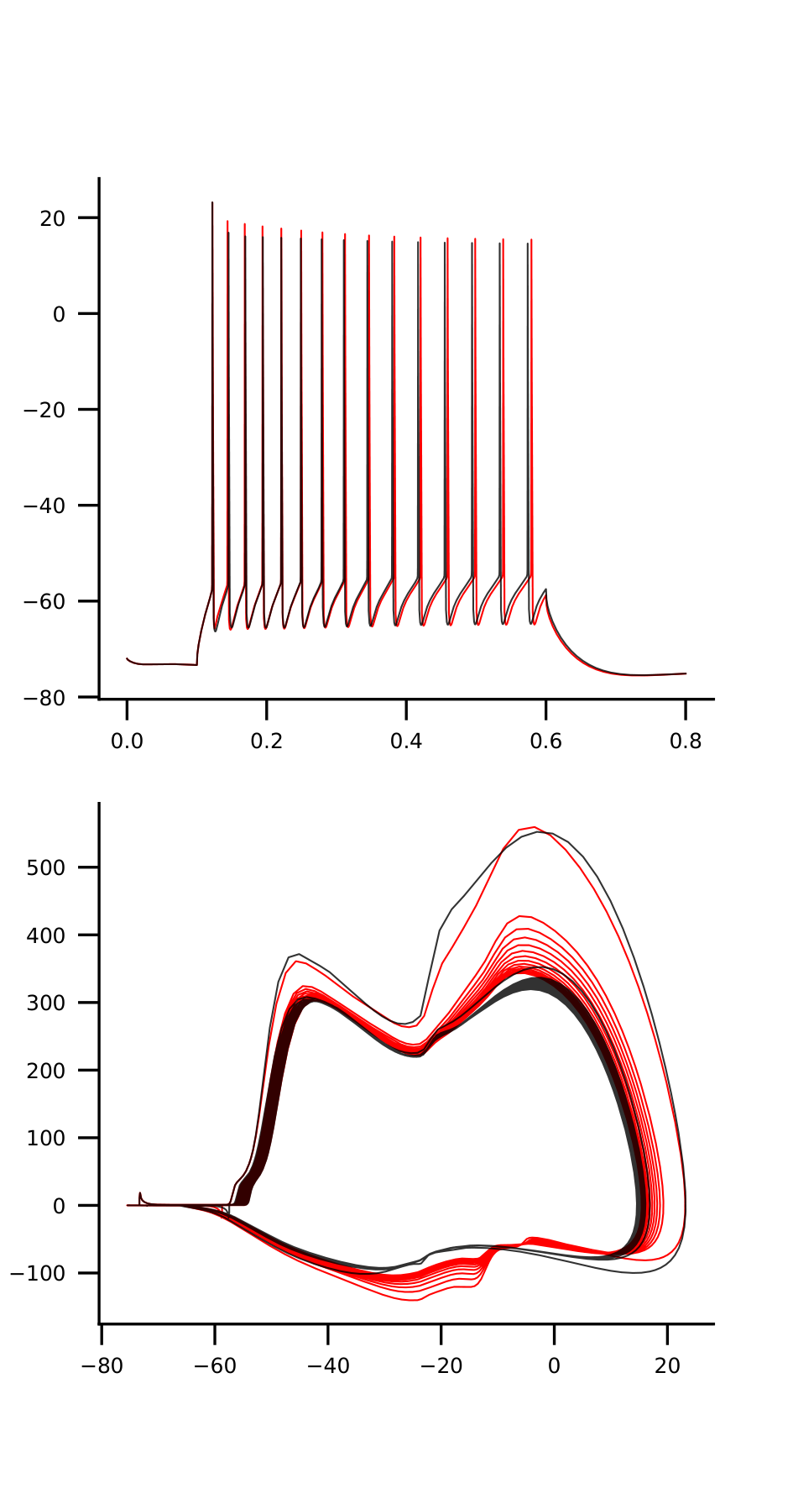
mut1_1_na12-1.25_na16-1.25

Slide 5
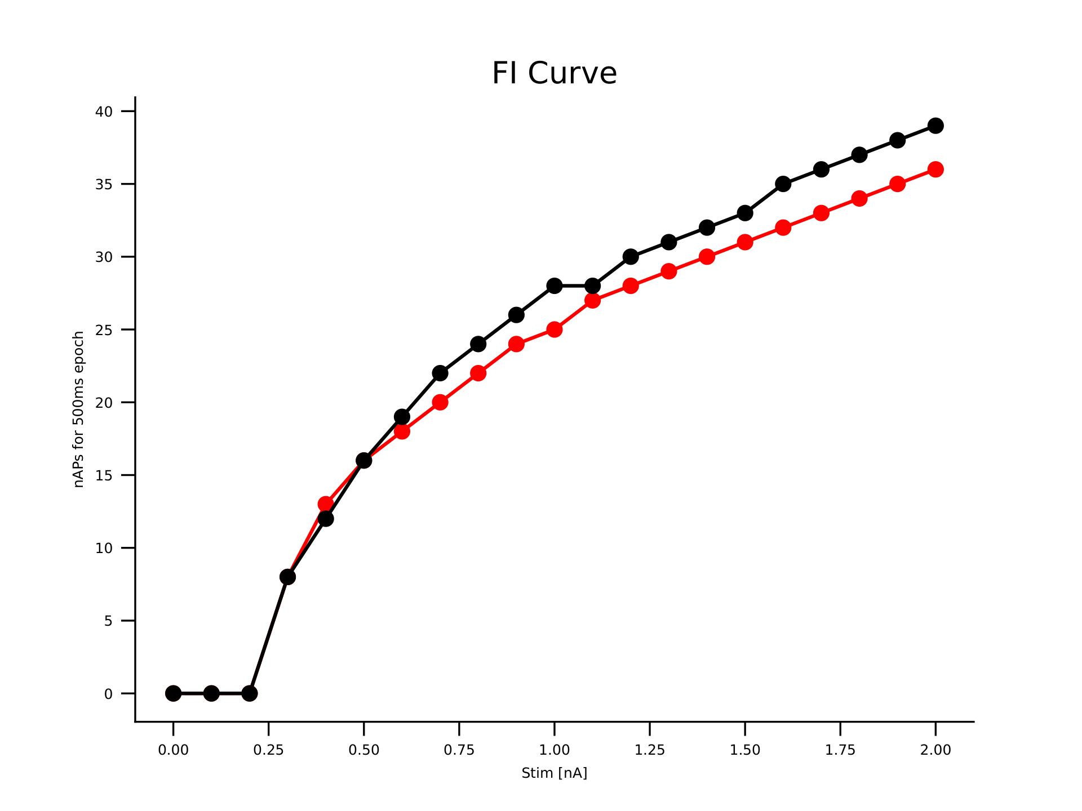
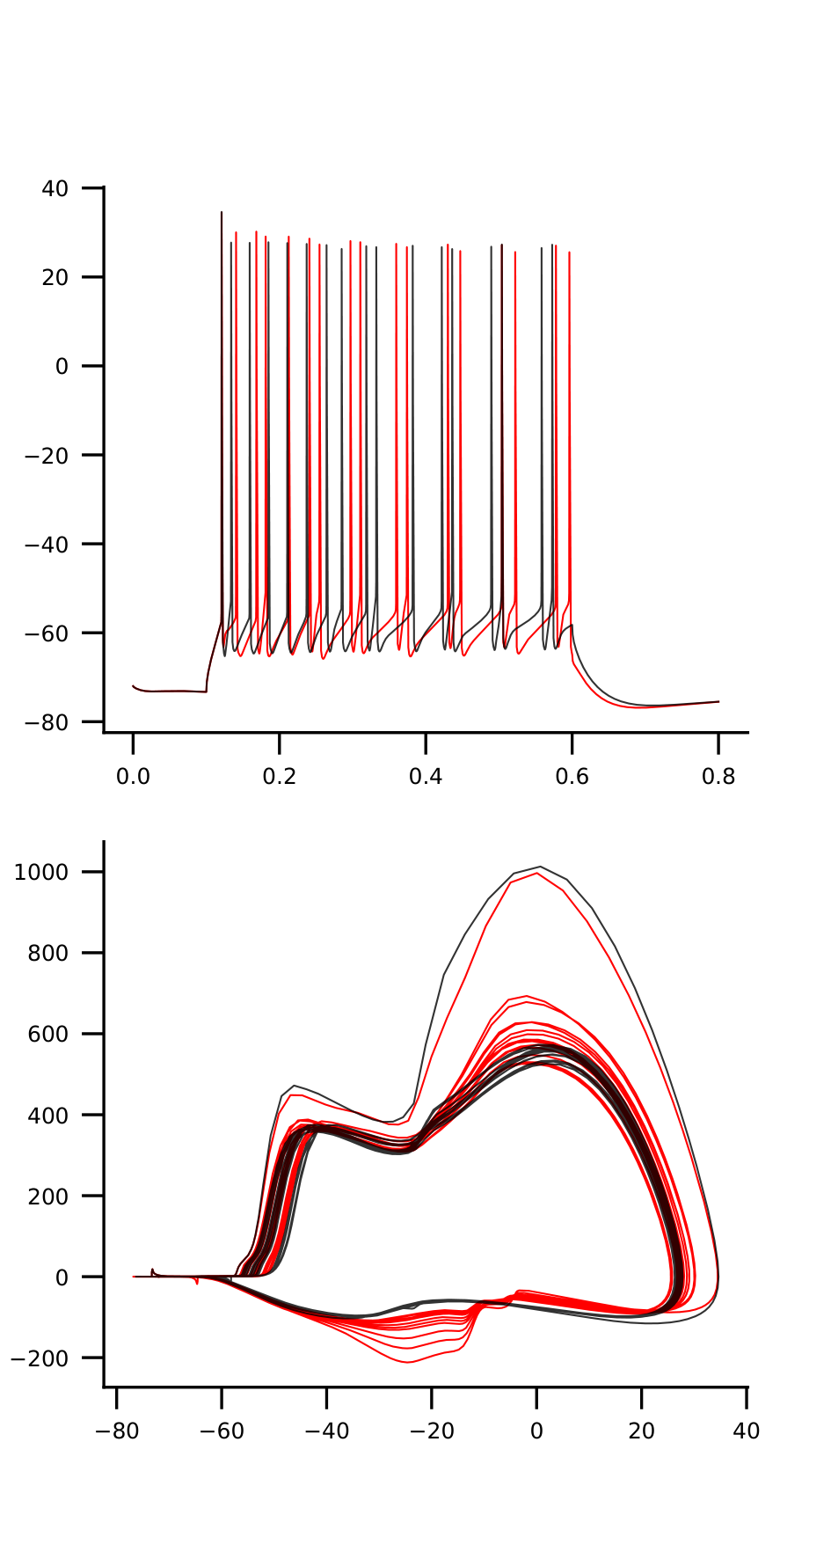
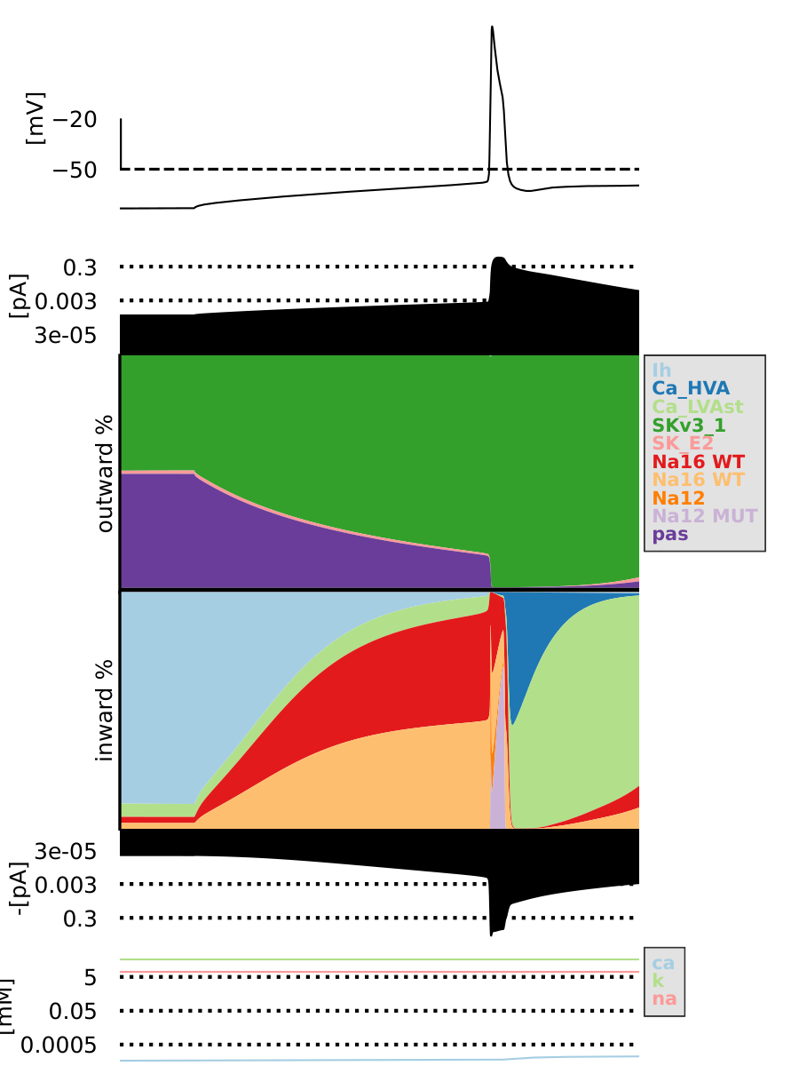
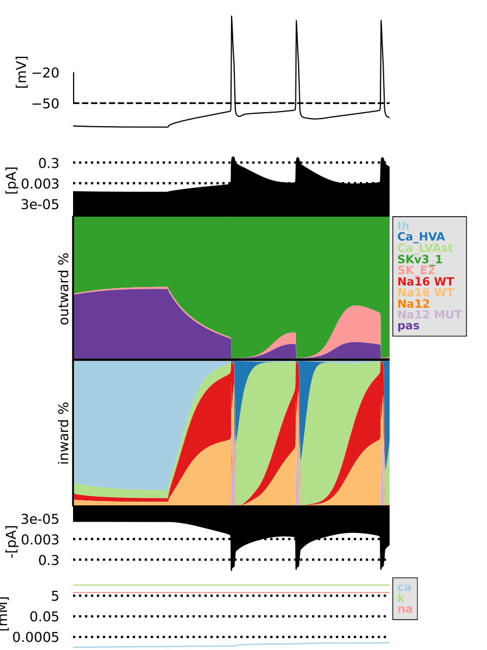
mut1_1_na12-2.75_na16-2.25

Slide 6
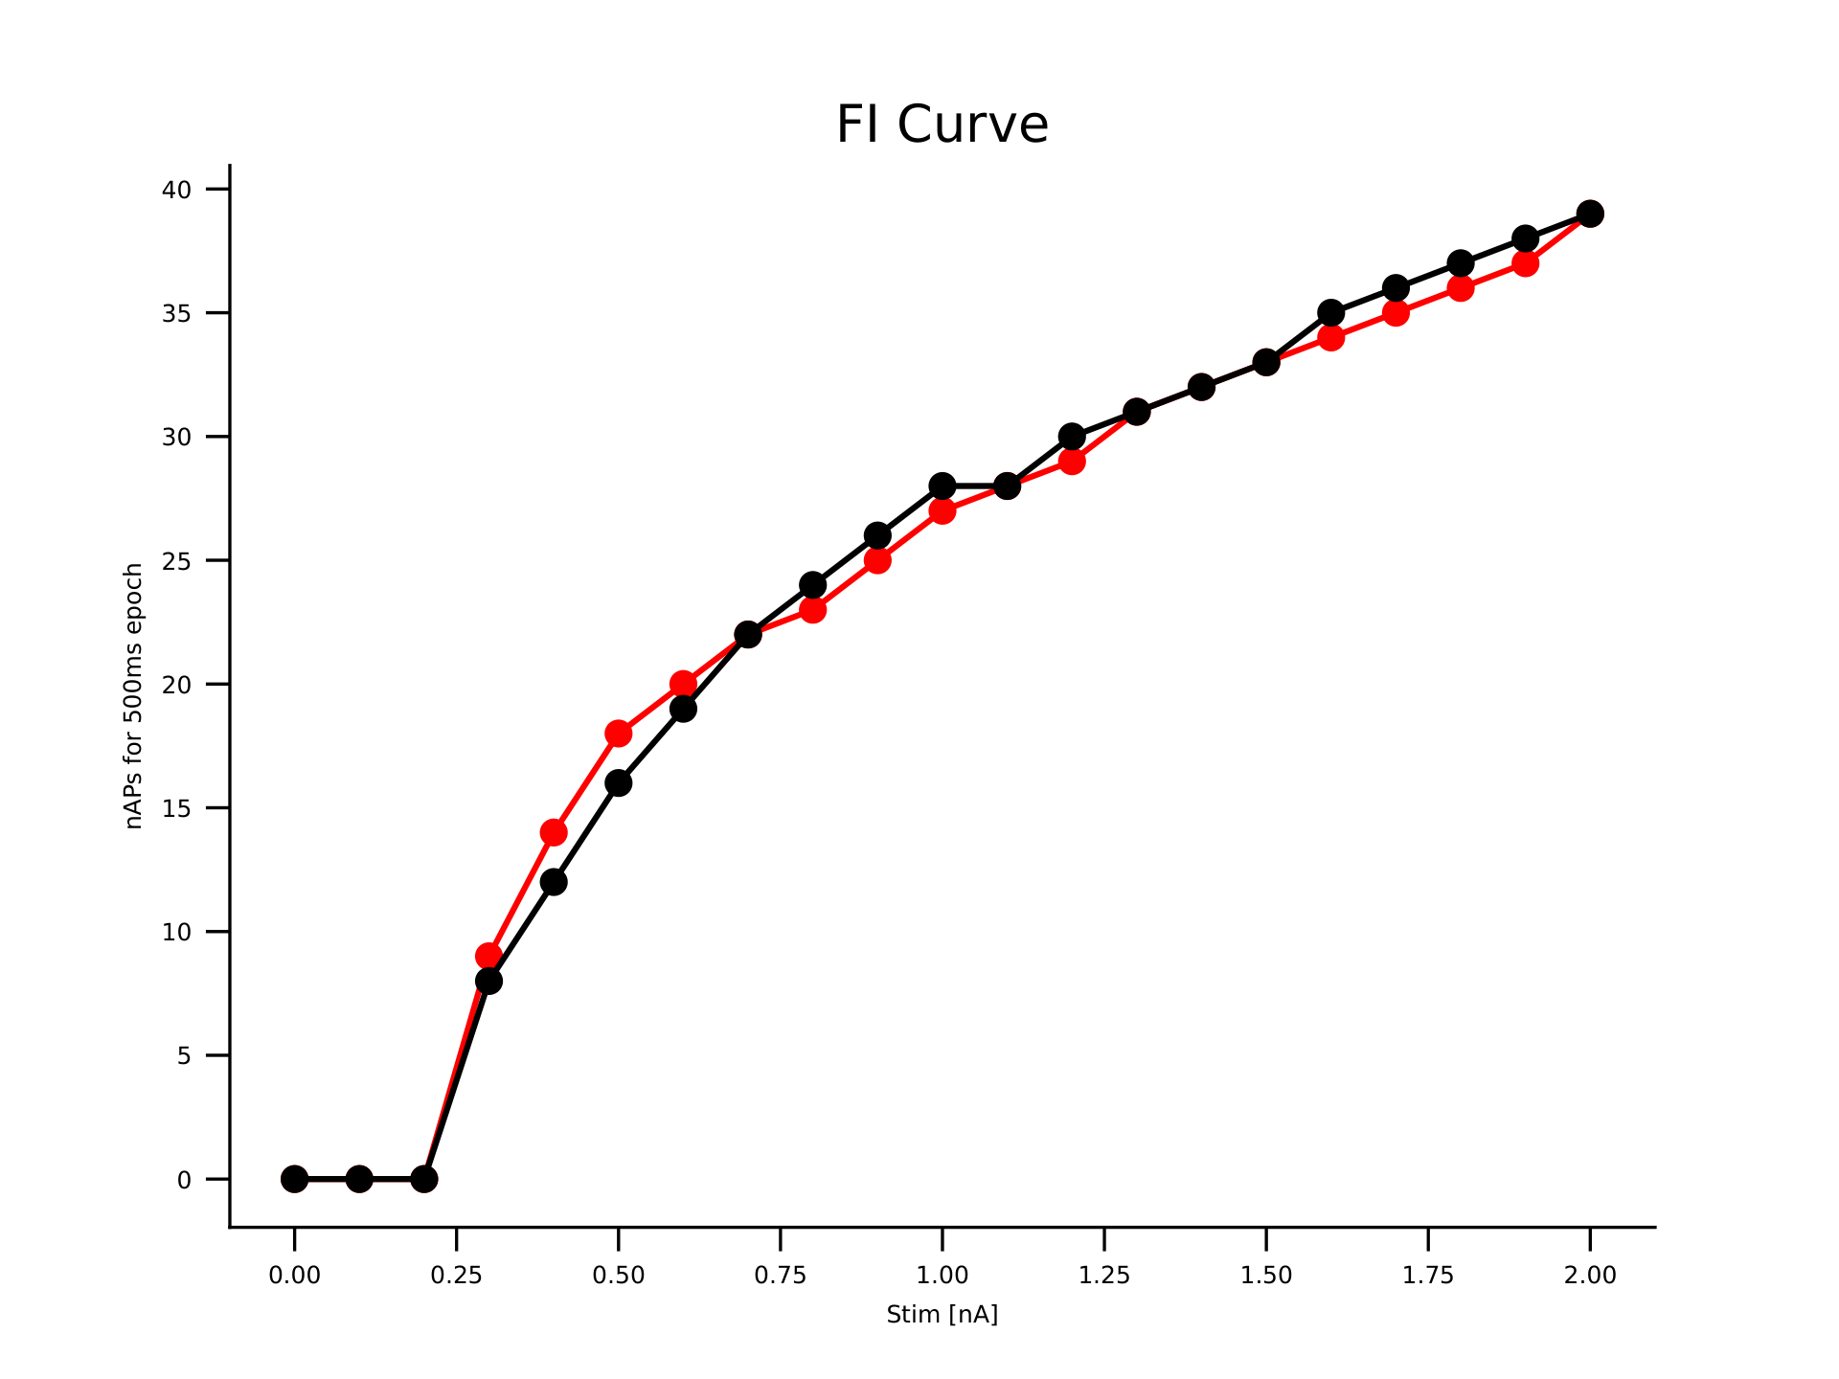
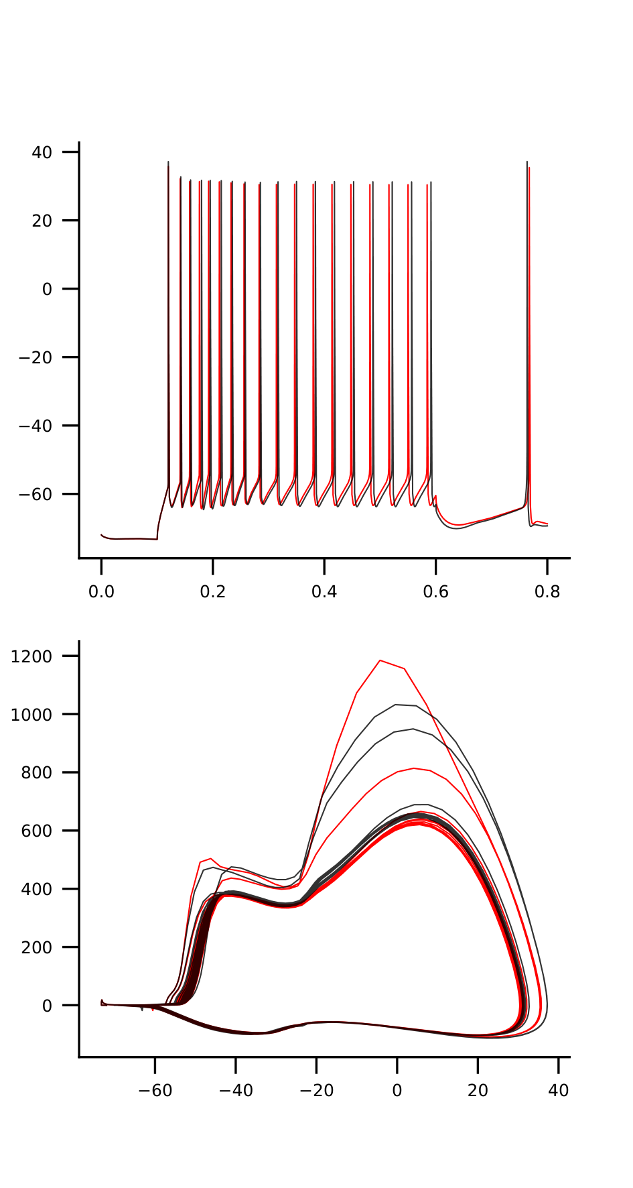
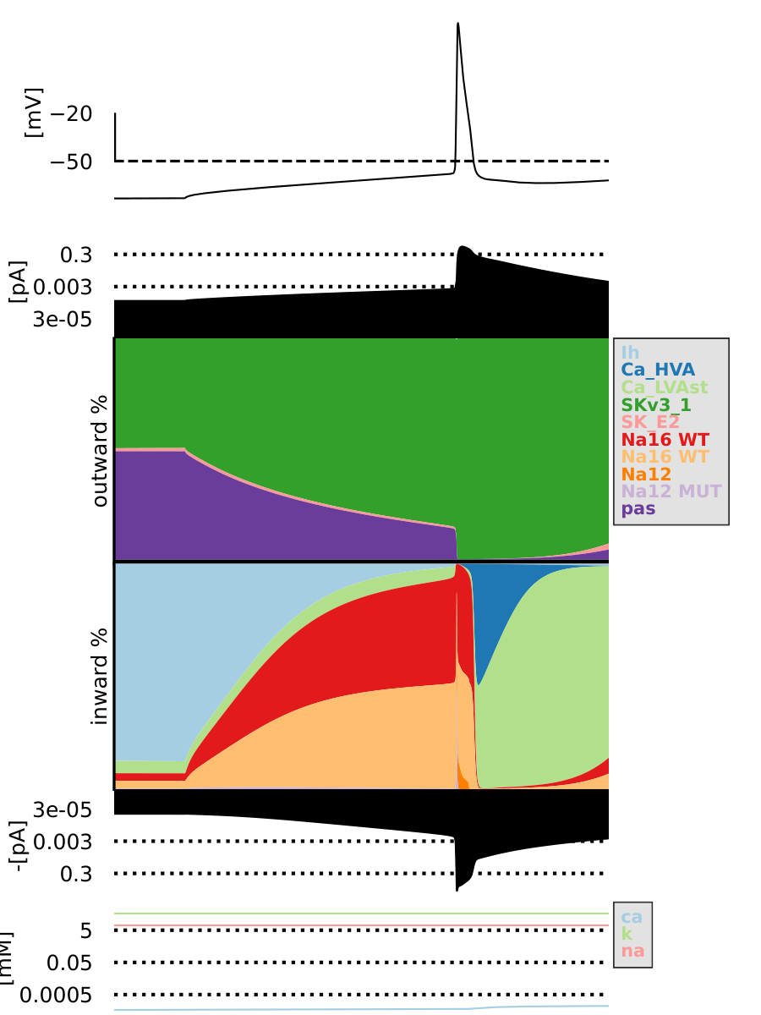
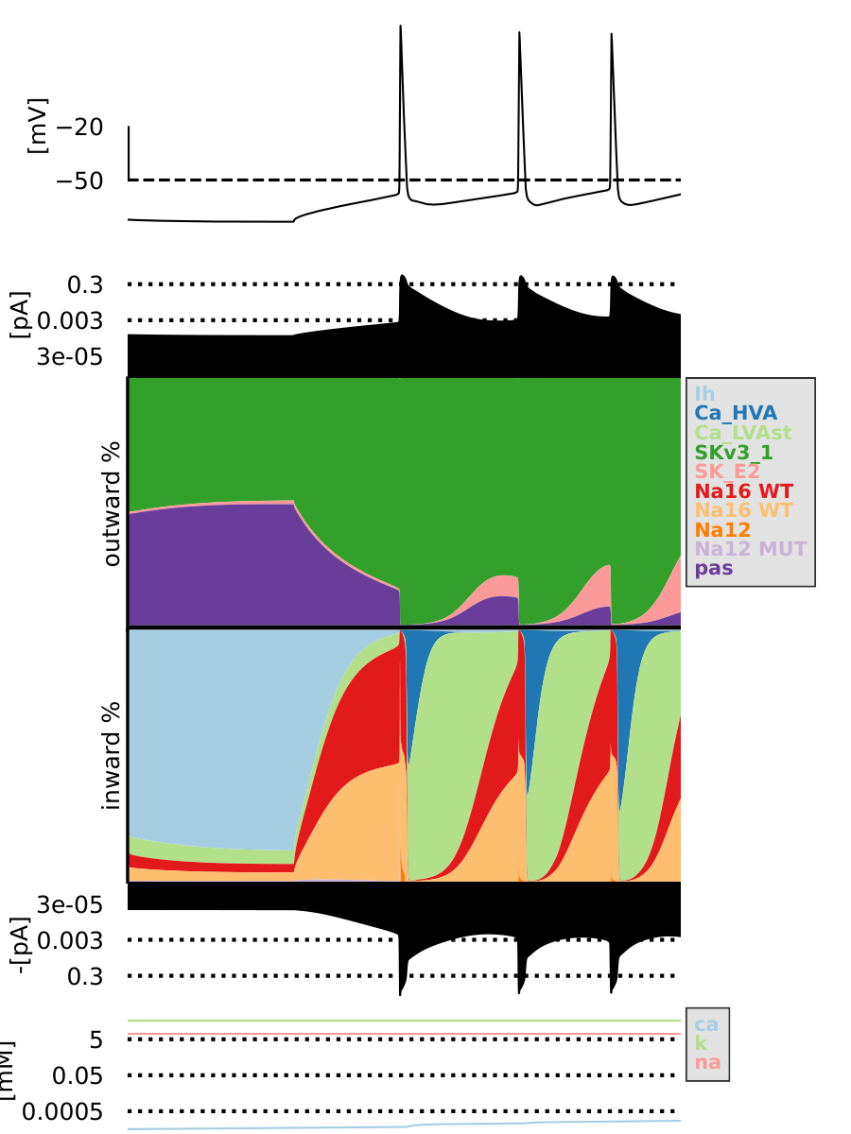
mut2_2_na12-2.5_na16-3.0

Slide 7

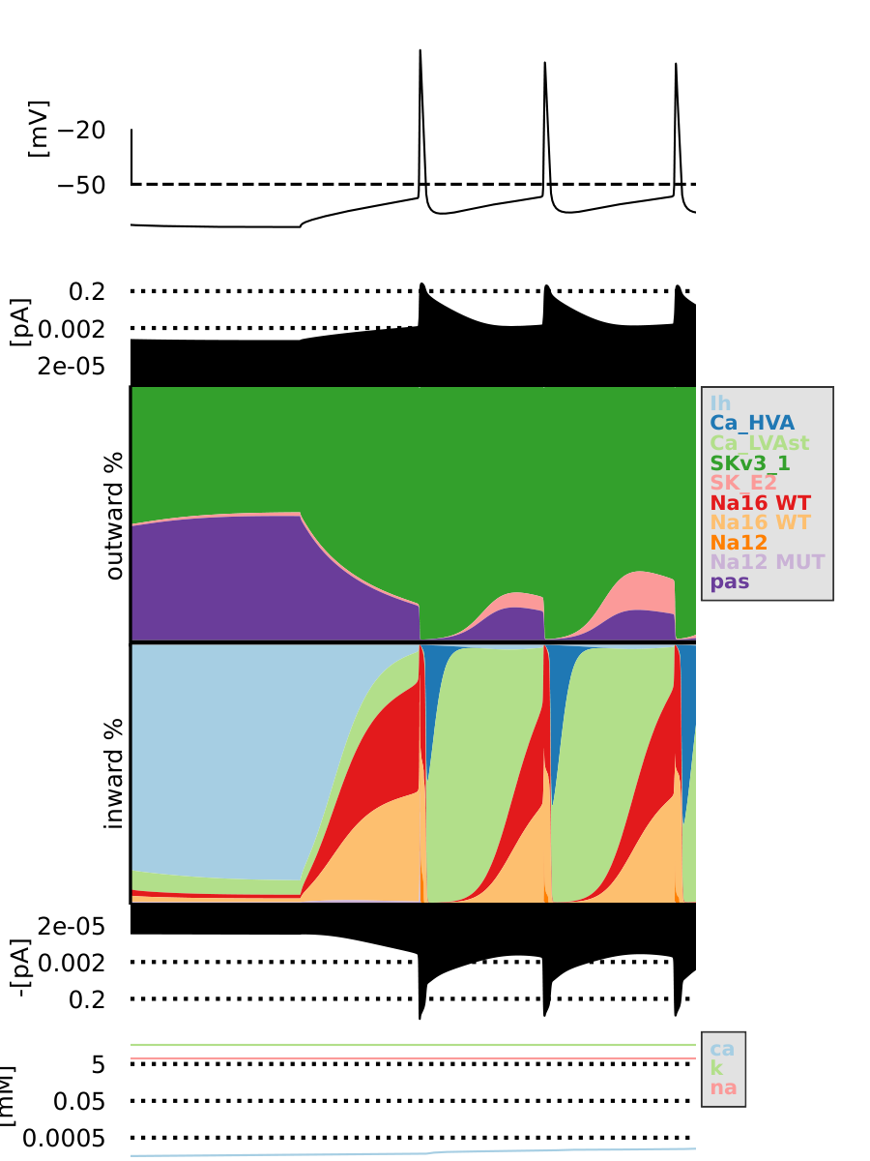
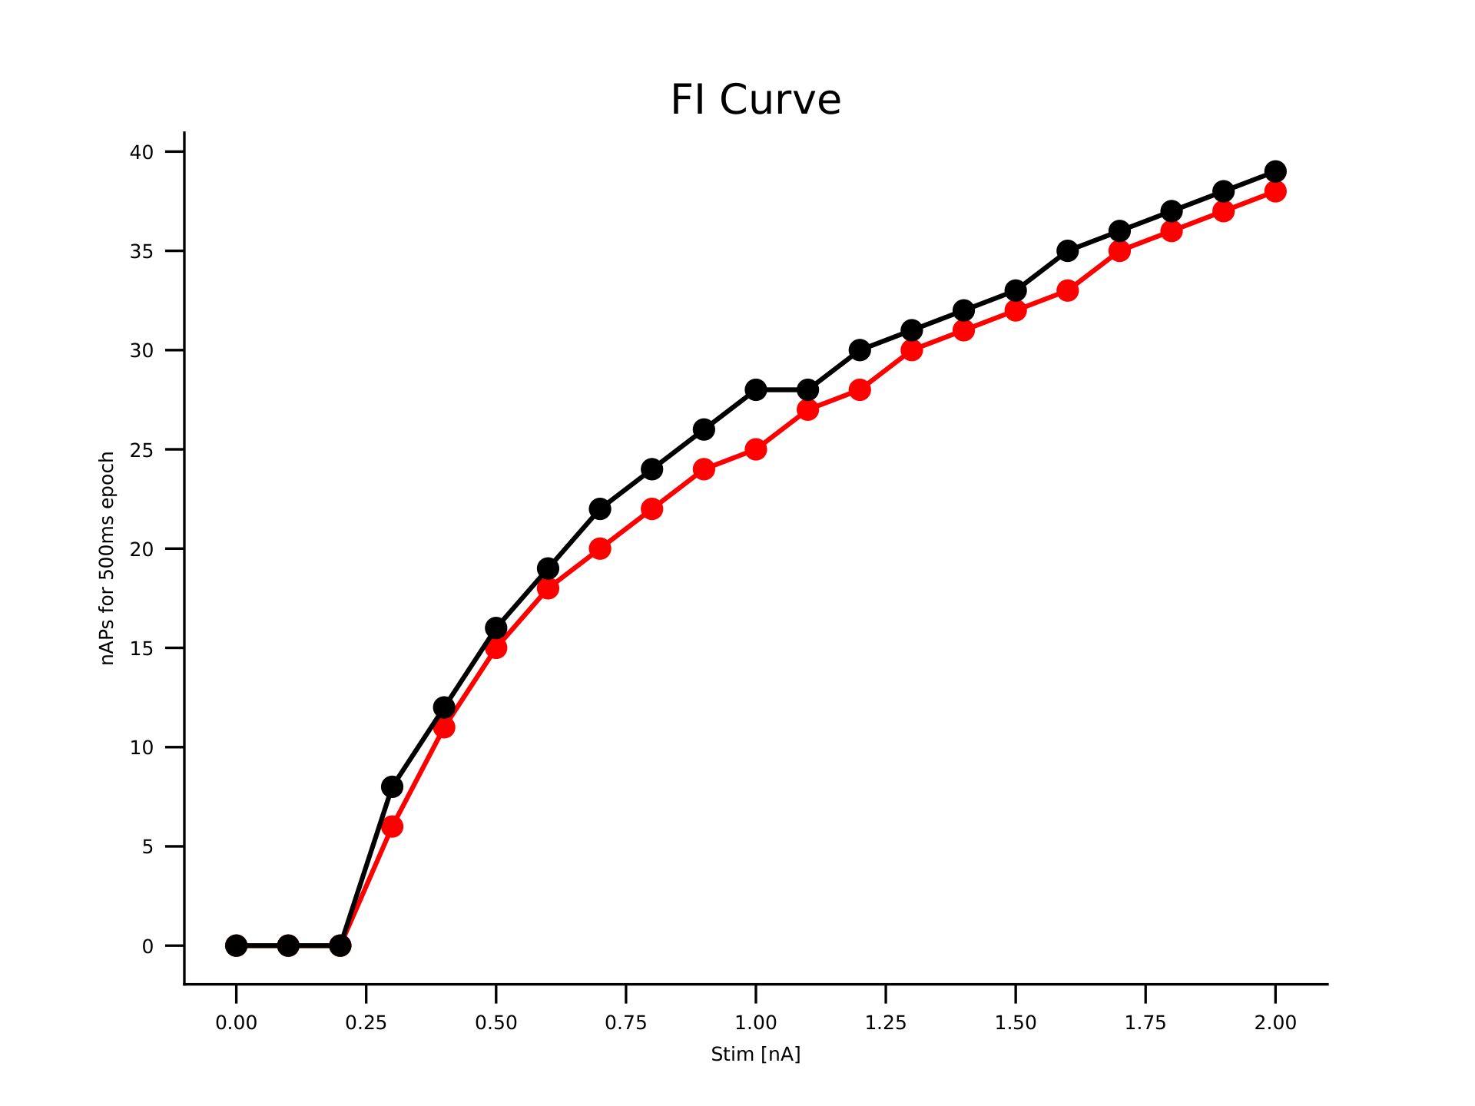
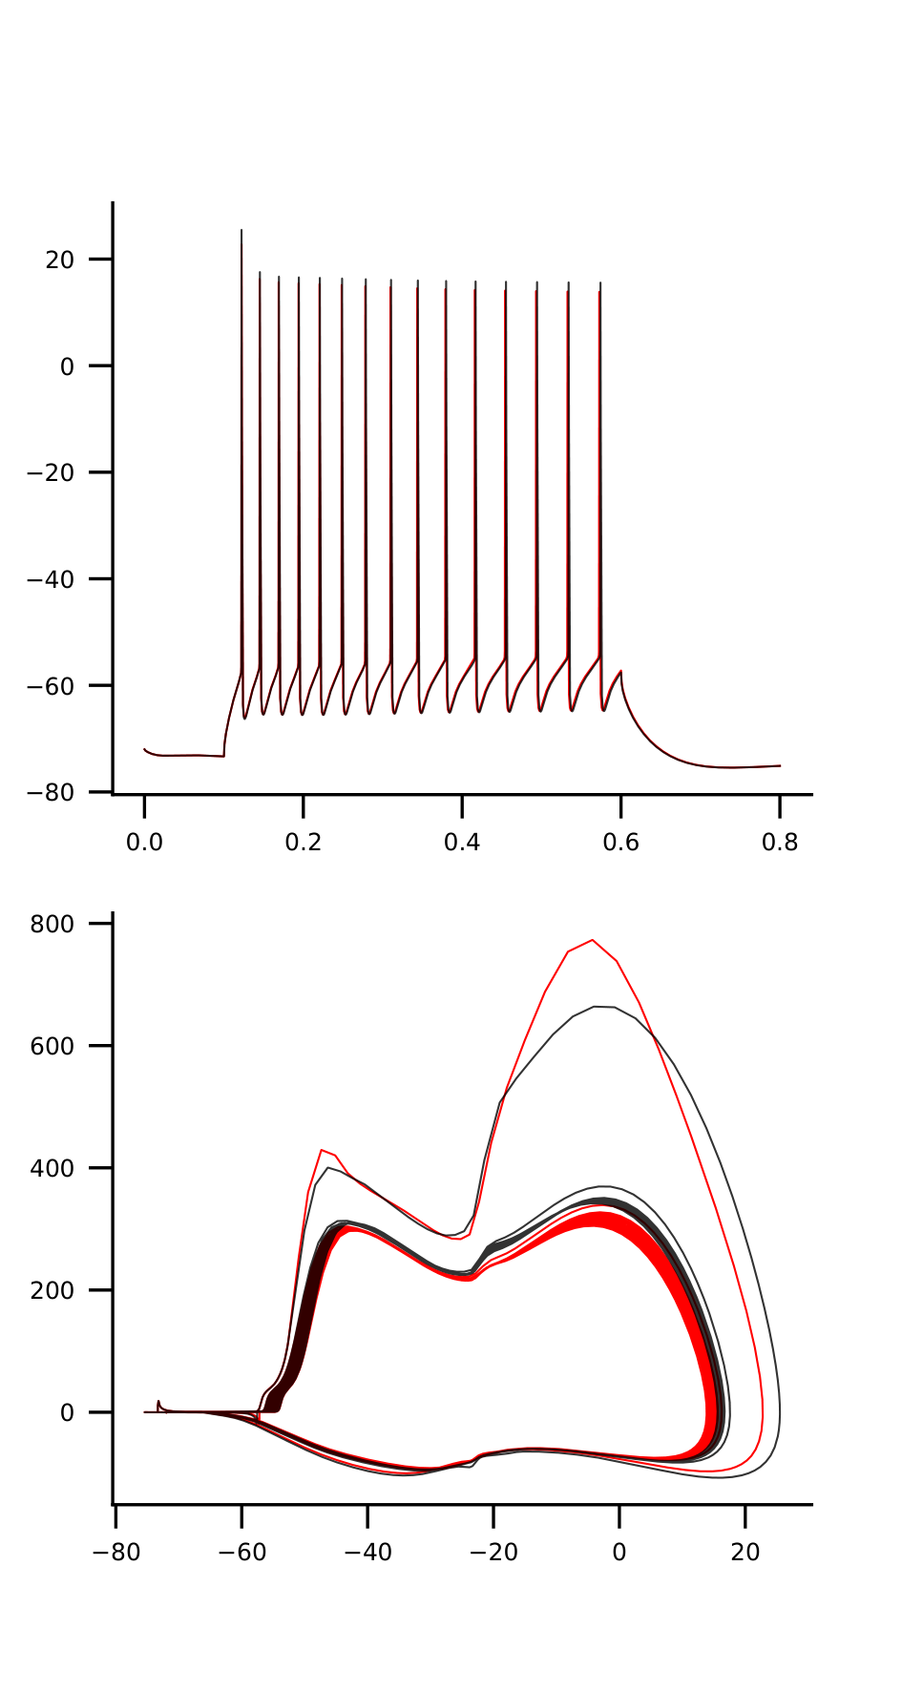
mut2_2_na12-1.75_na16-1.25

Slide 8
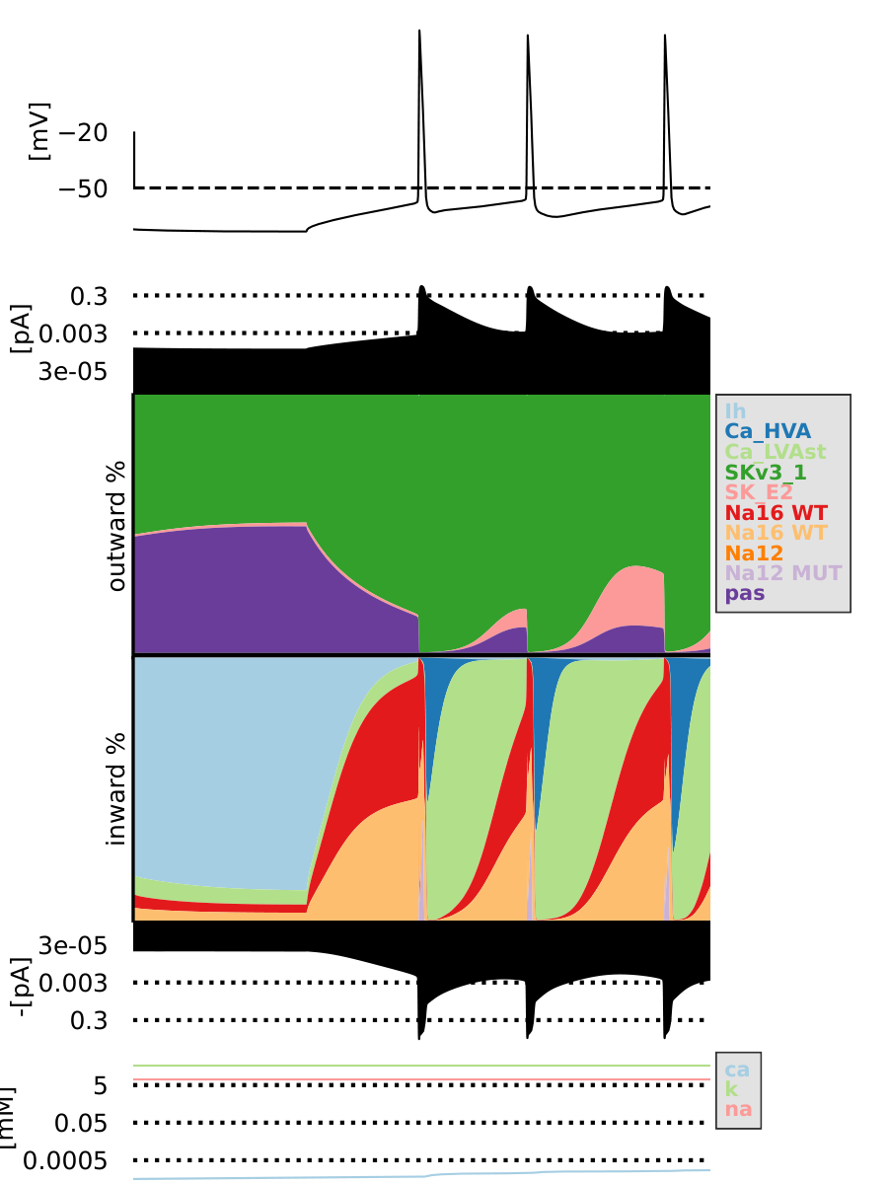
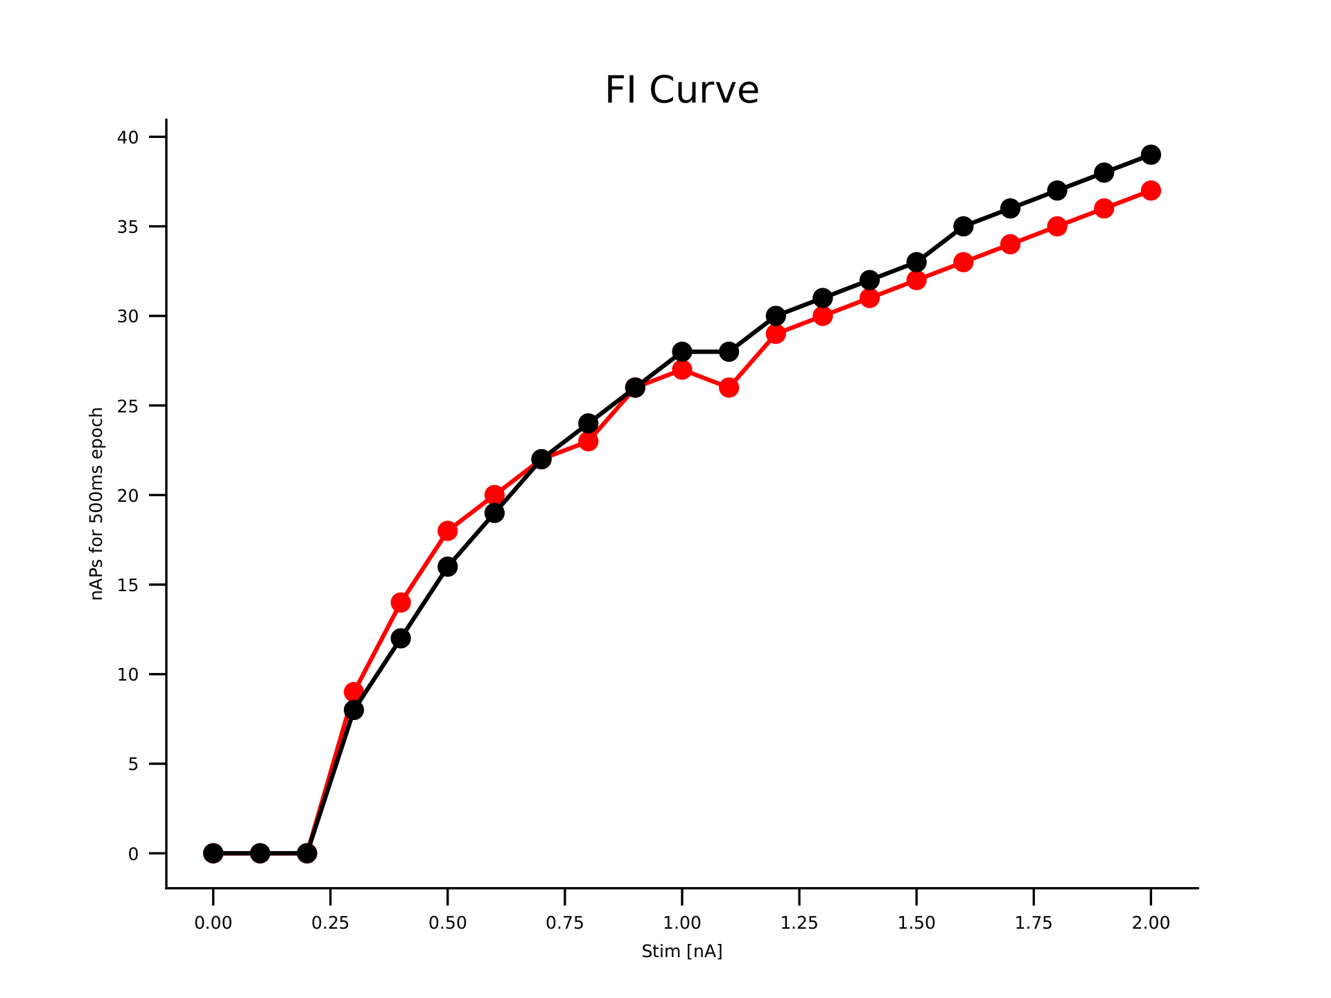
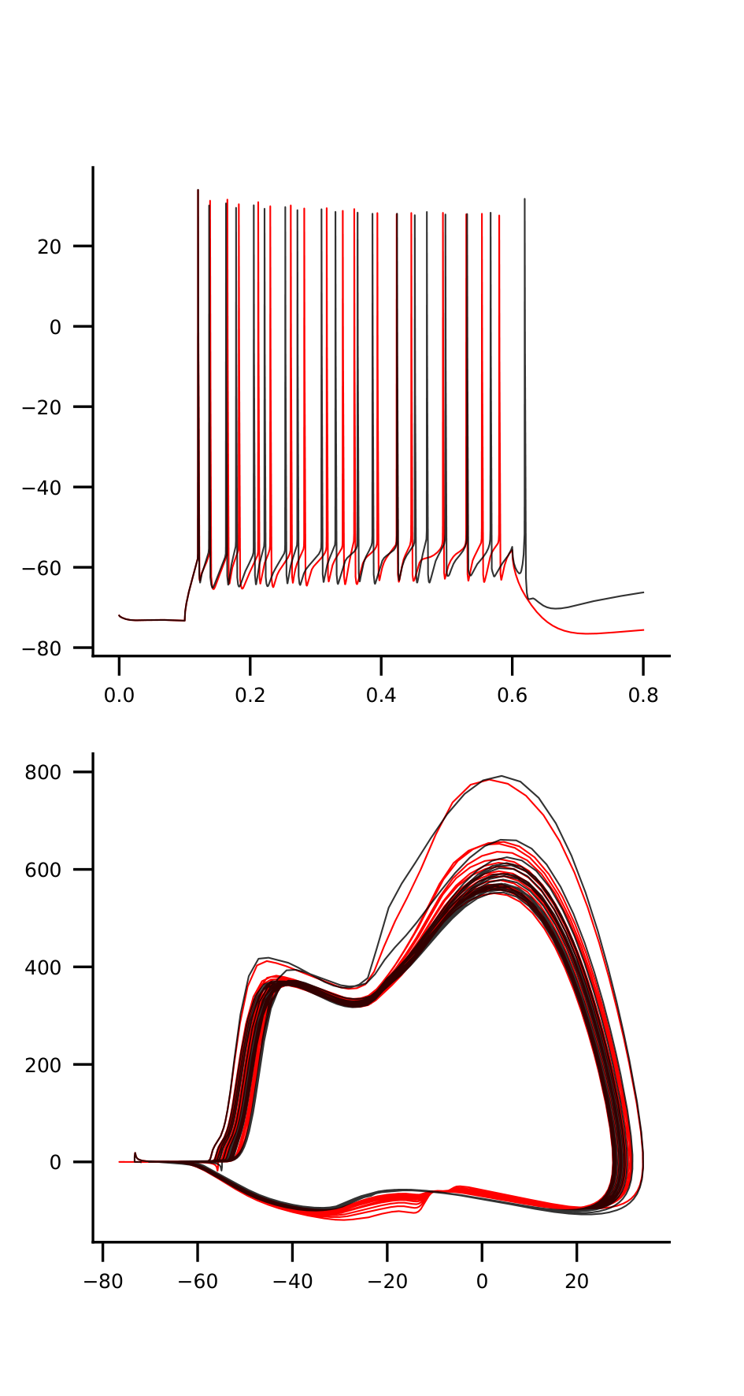
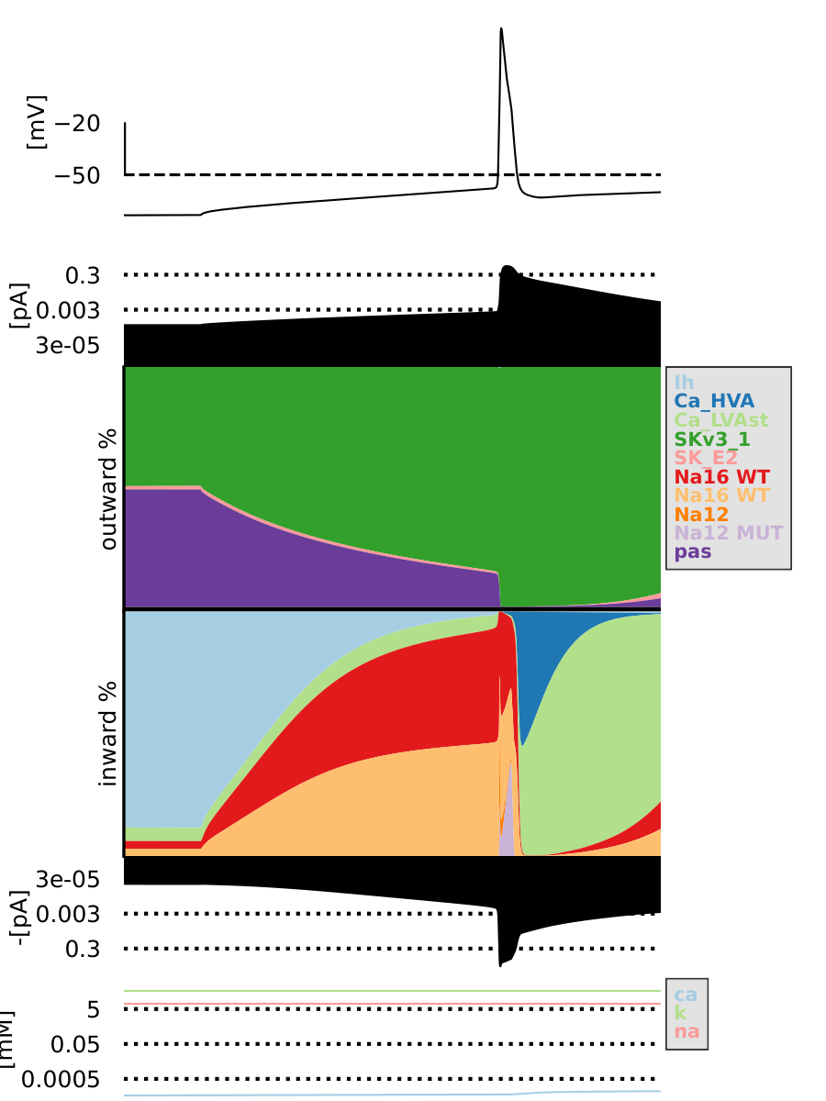
mut1_1_na12-1.25_na16-2.75

Slide 9
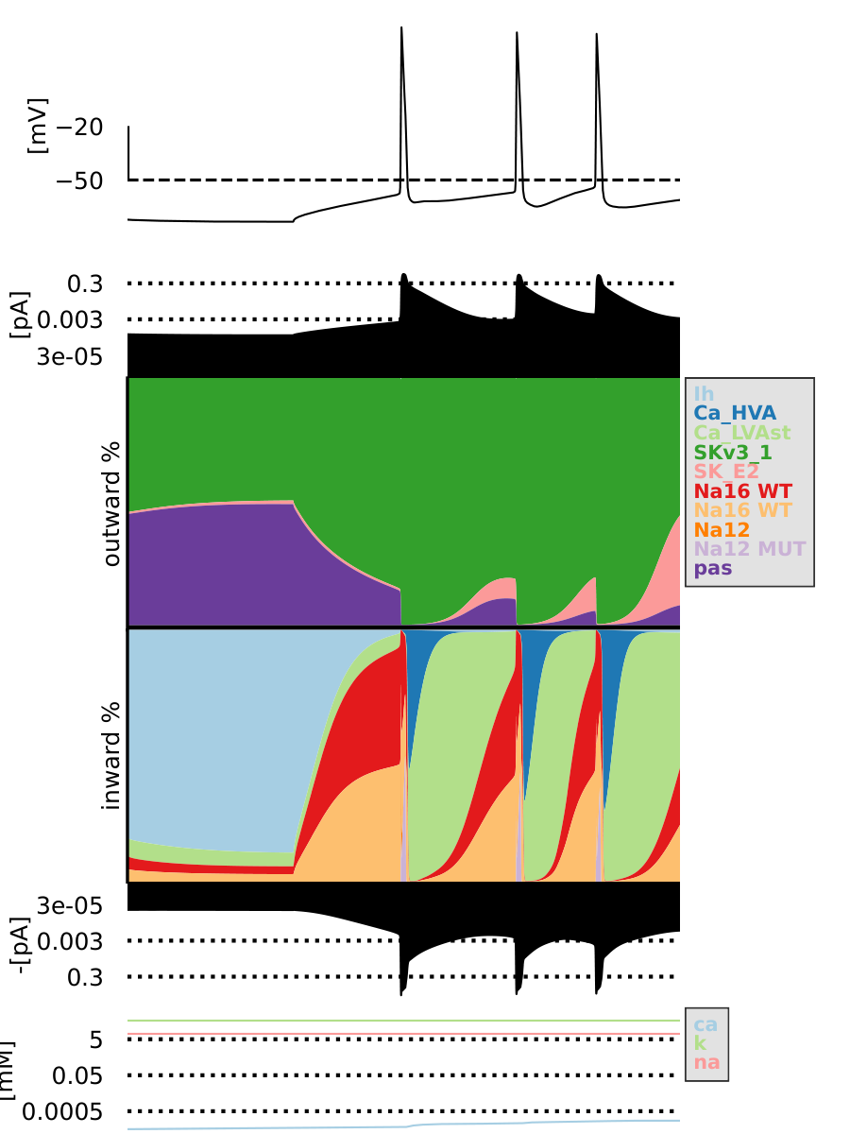
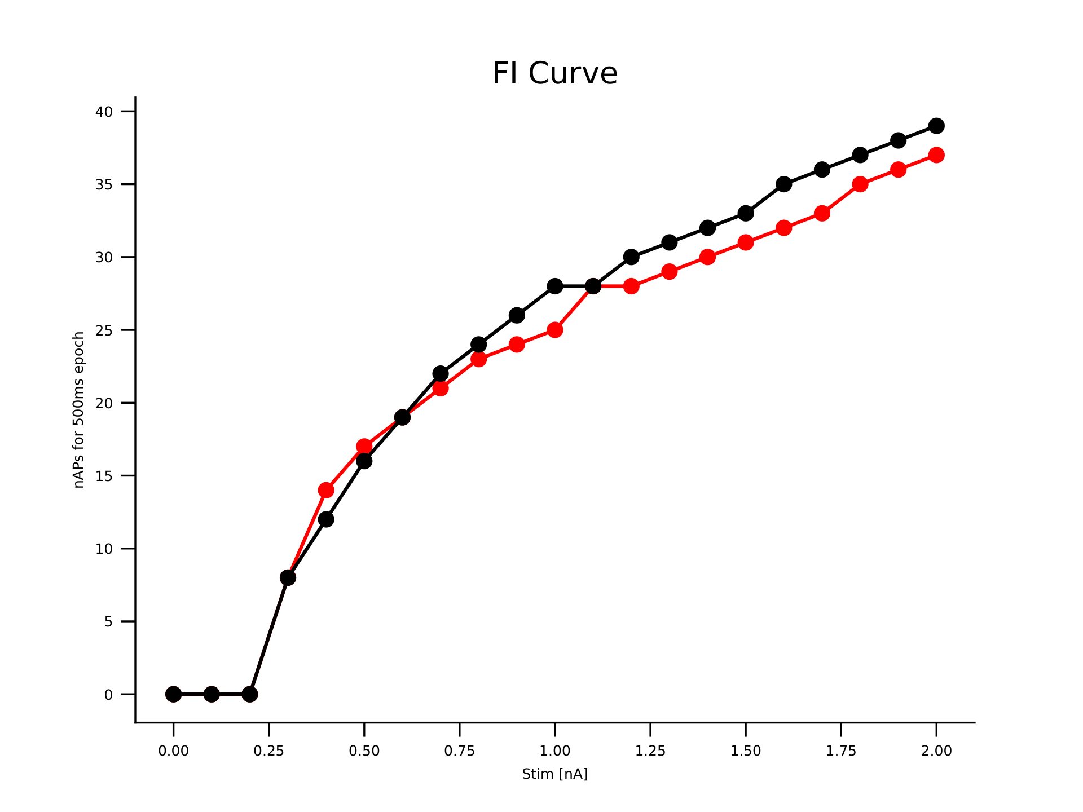
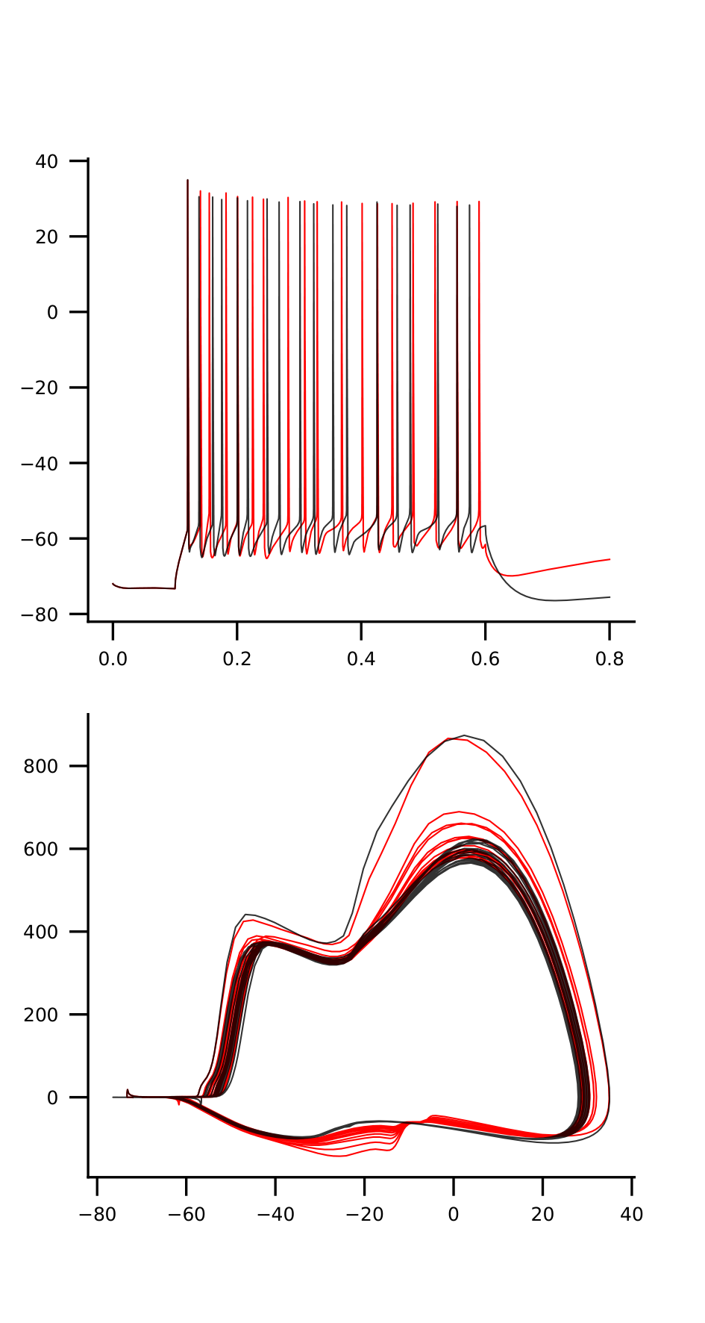
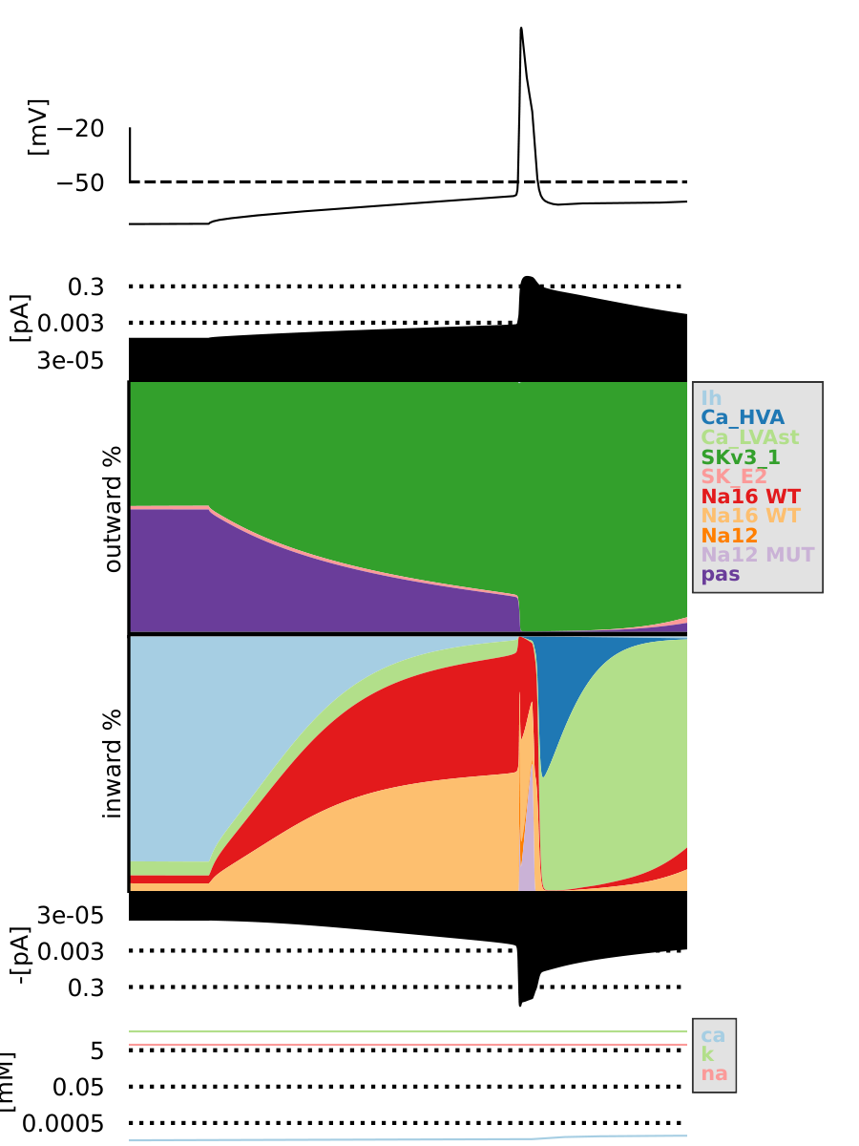
mut1_1_na12-1.75_na16-2.75

Slide 10
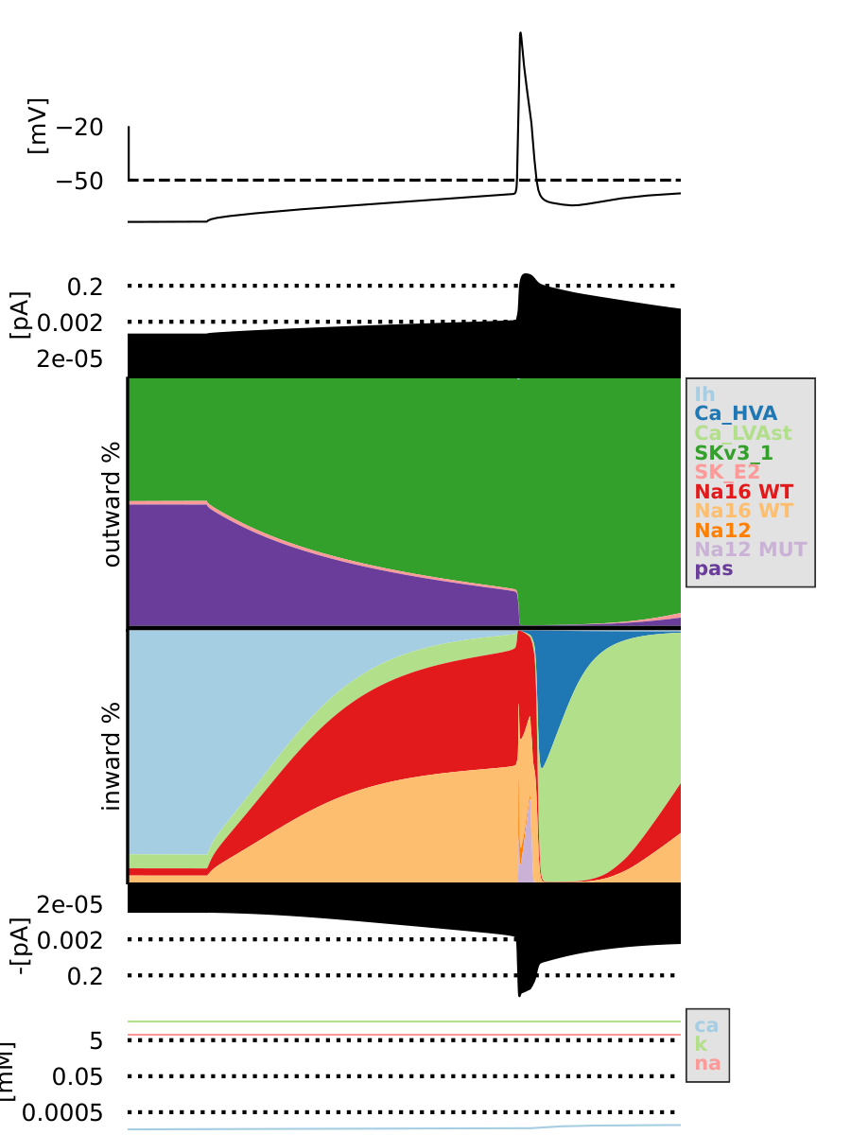

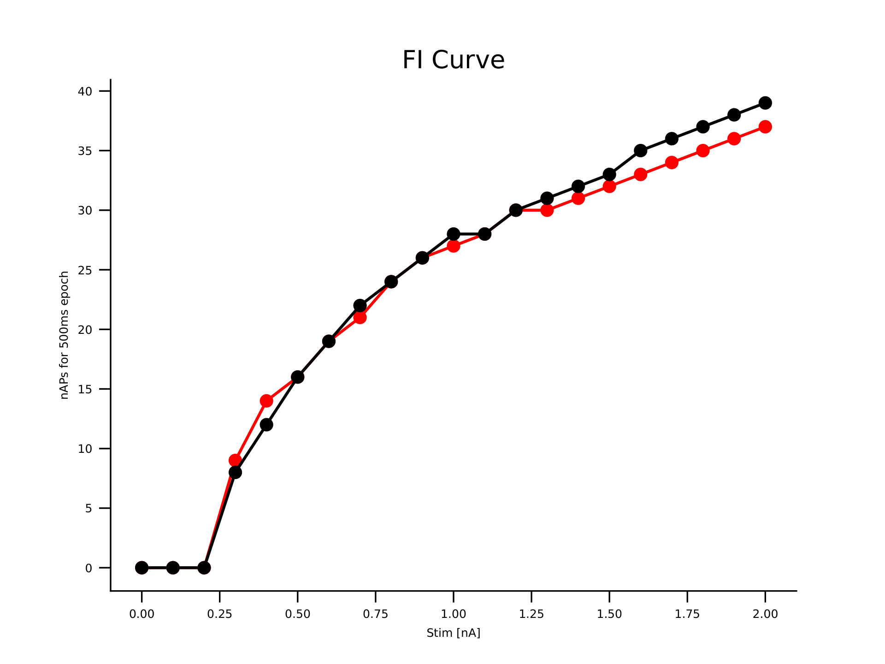
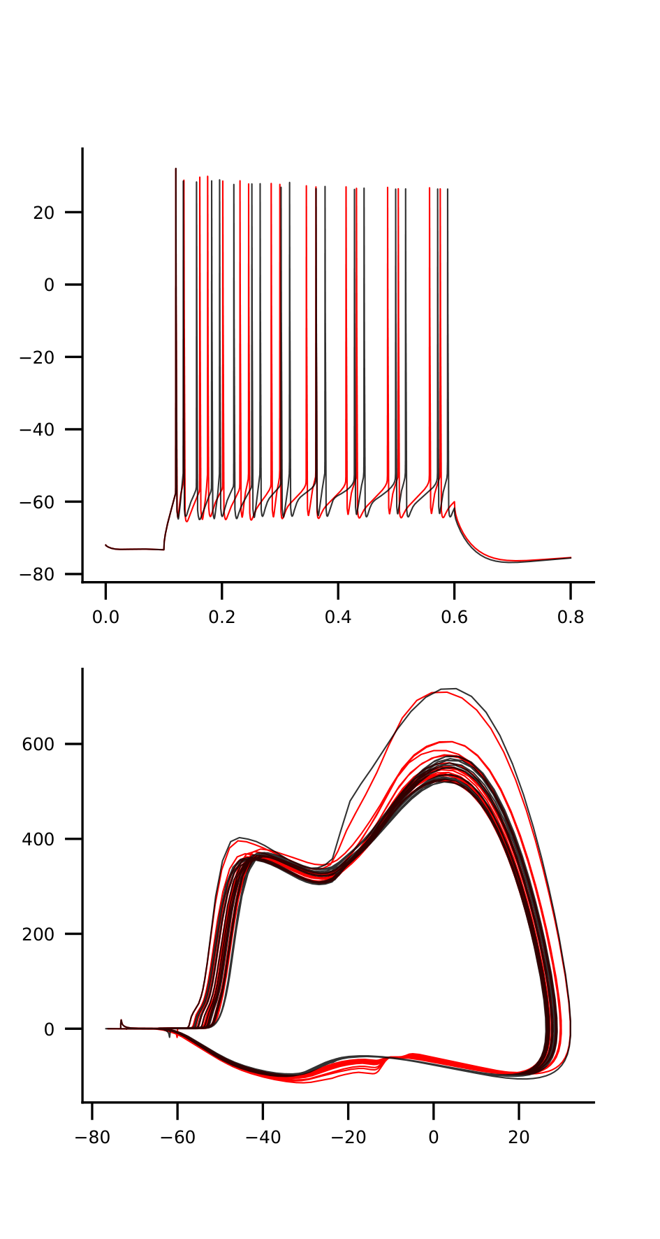
mut1_1_na12-1.0_na16-2.5

Slide 11
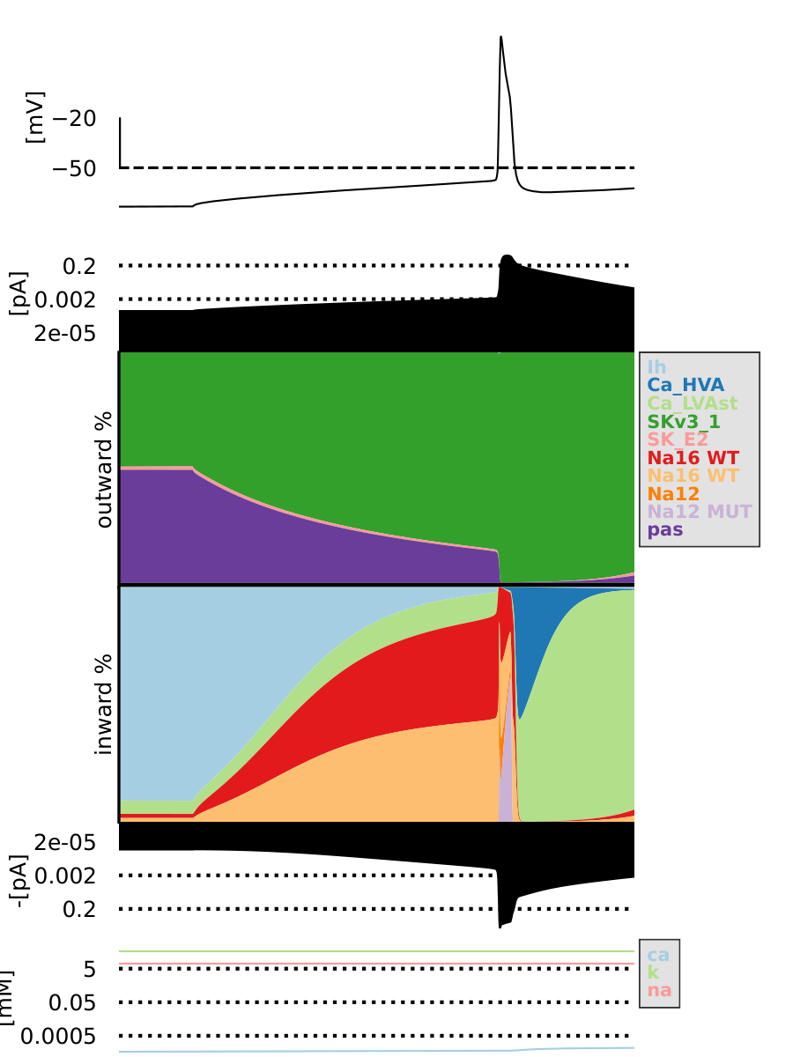

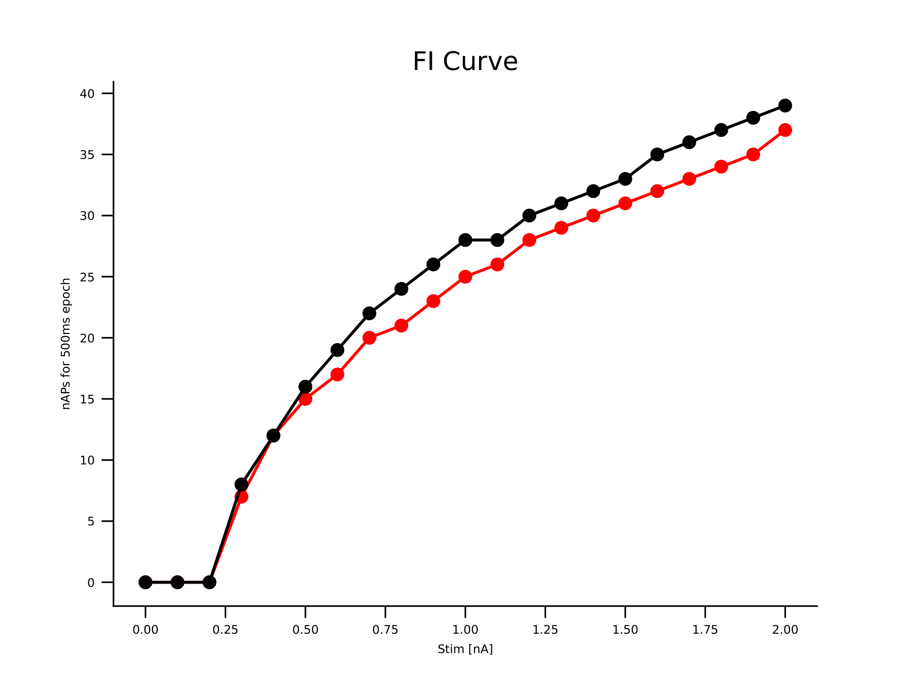
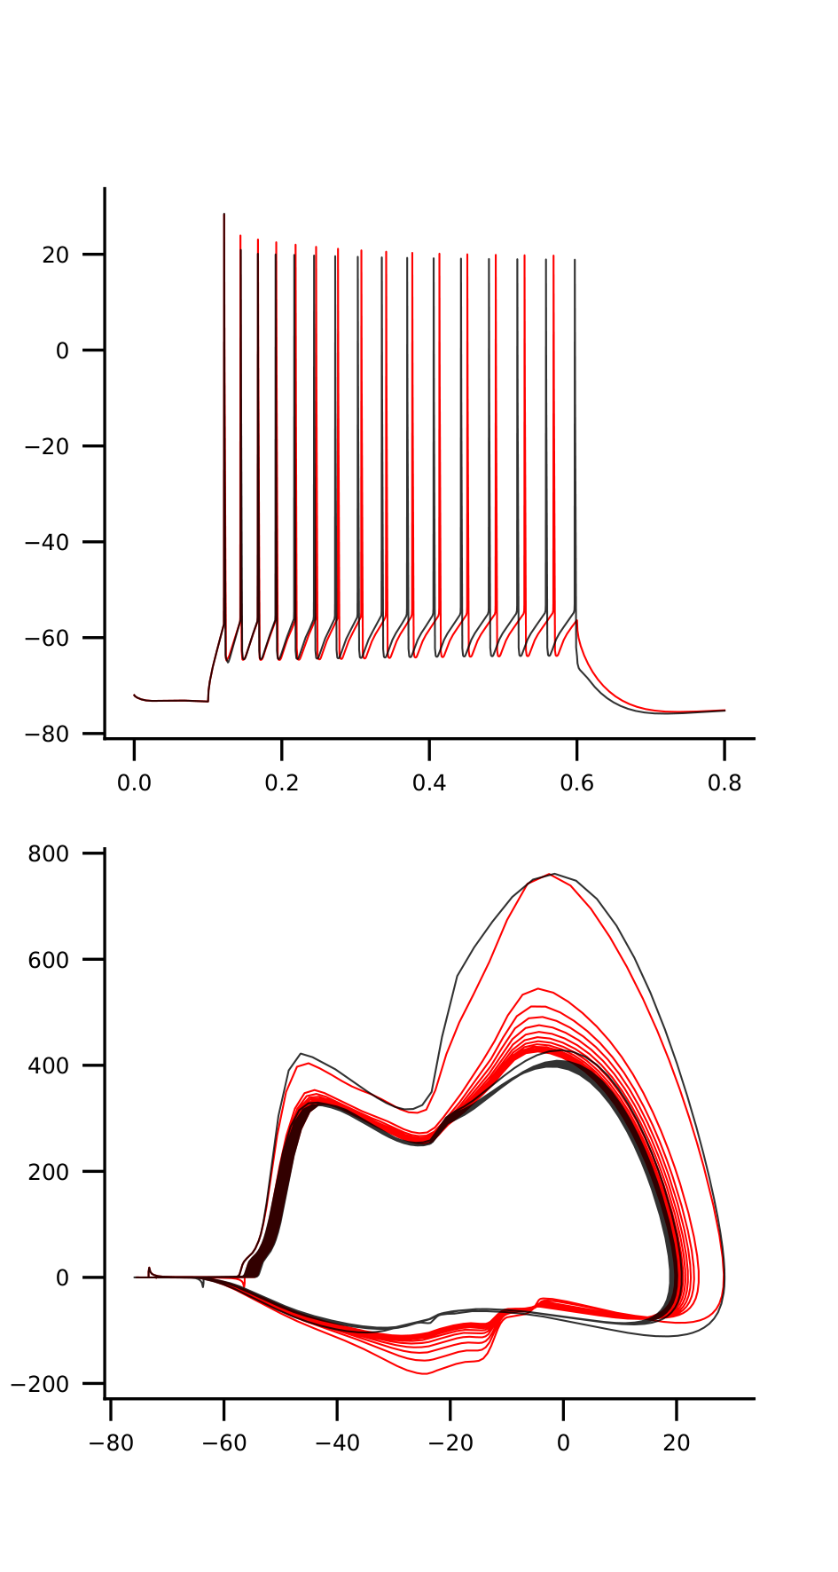
mut1_1_na12-2.0_na16-1.5

Slide 12
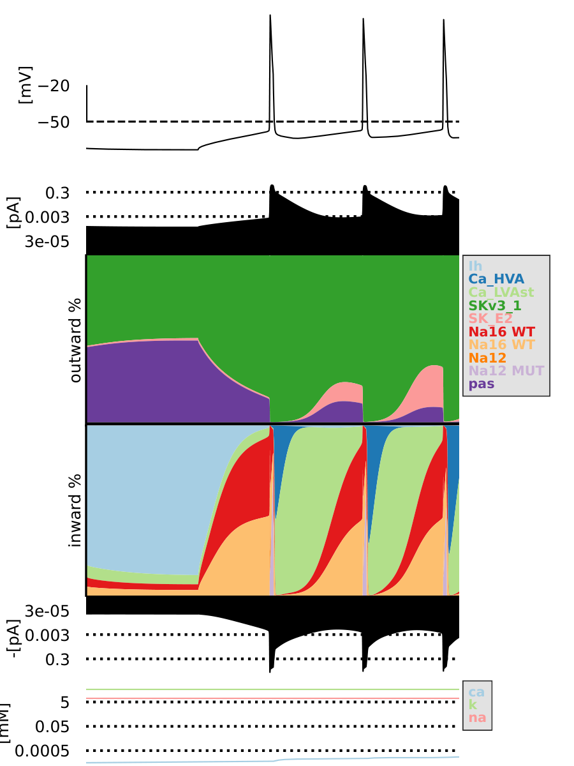
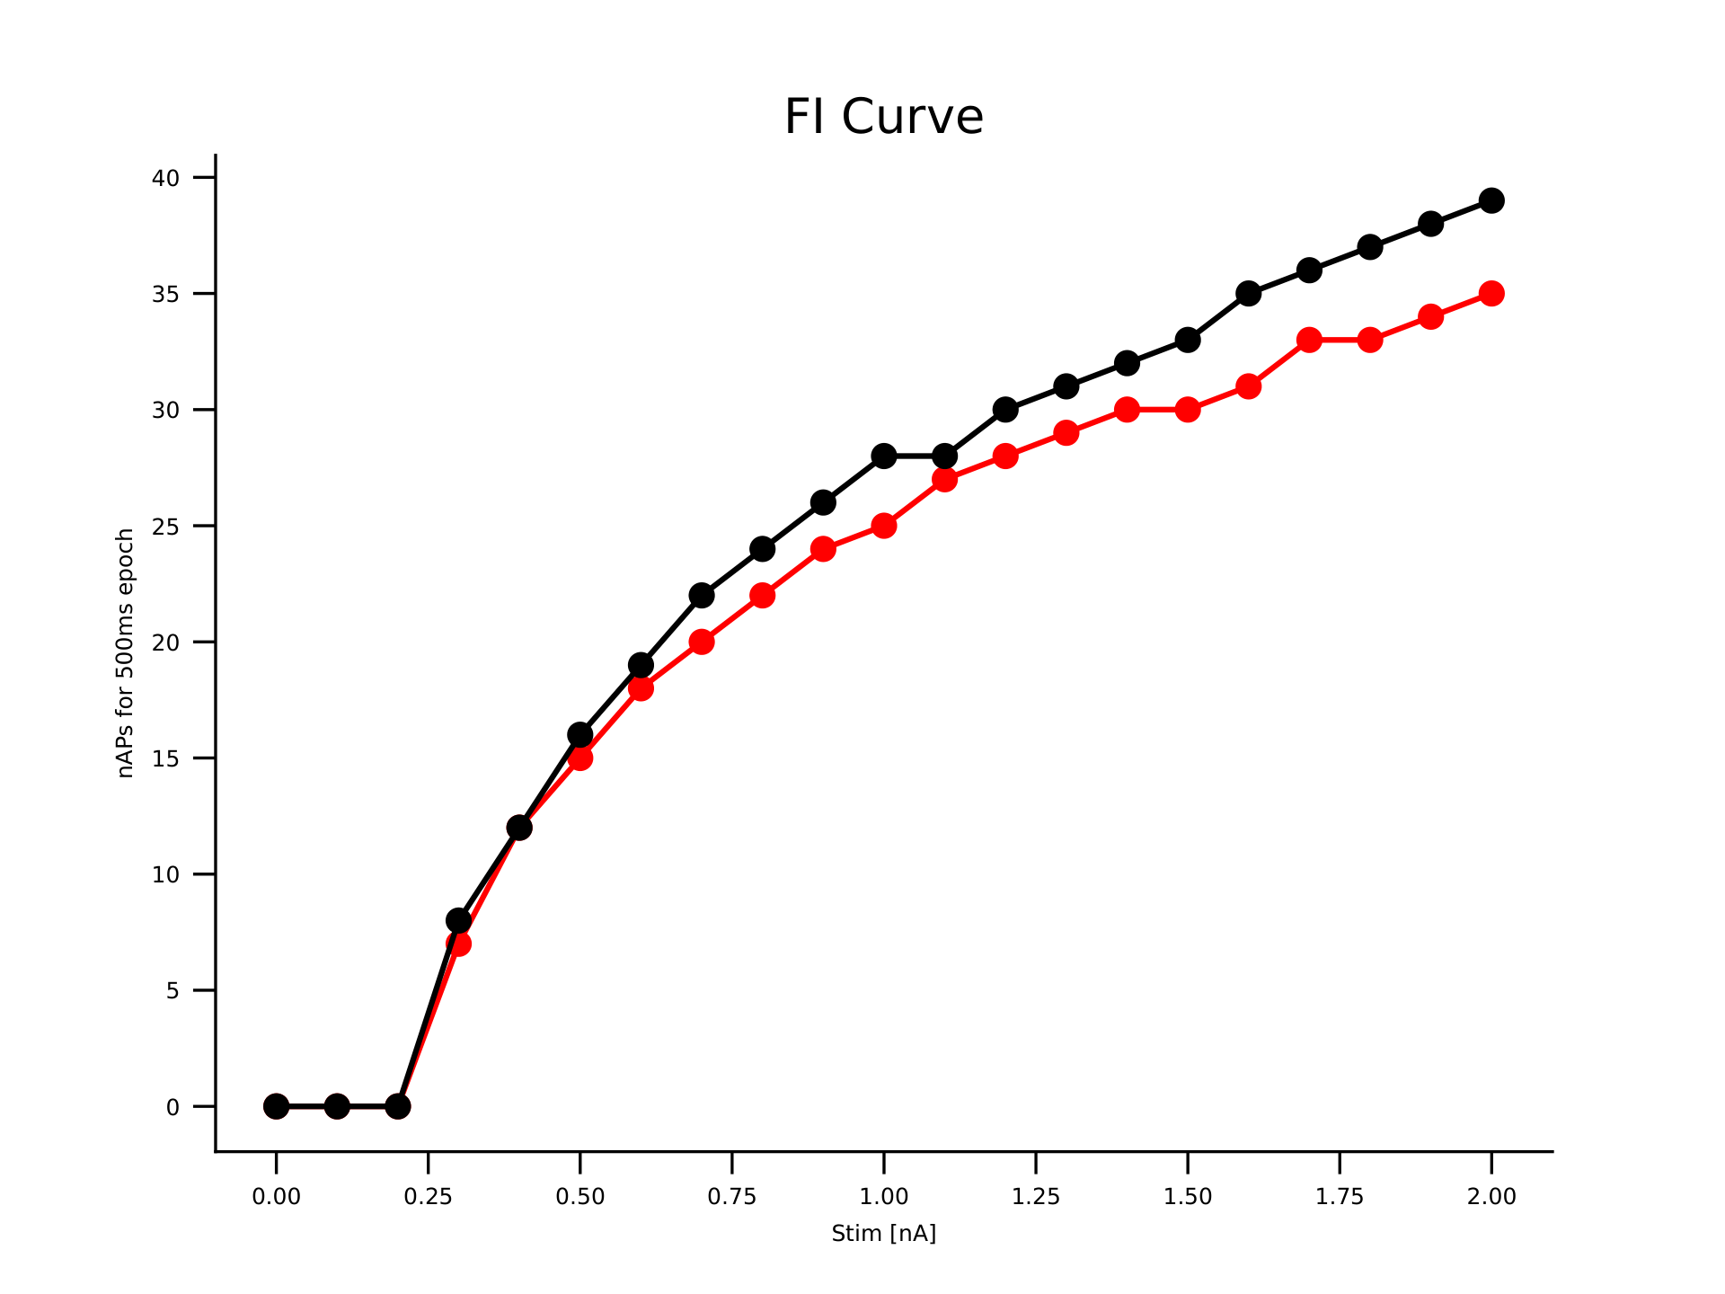
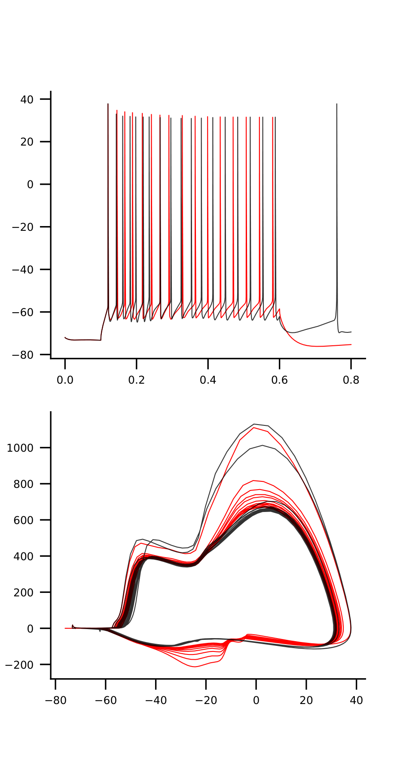

mut1_1_na12-3.0_na16-3.0

Slide 13

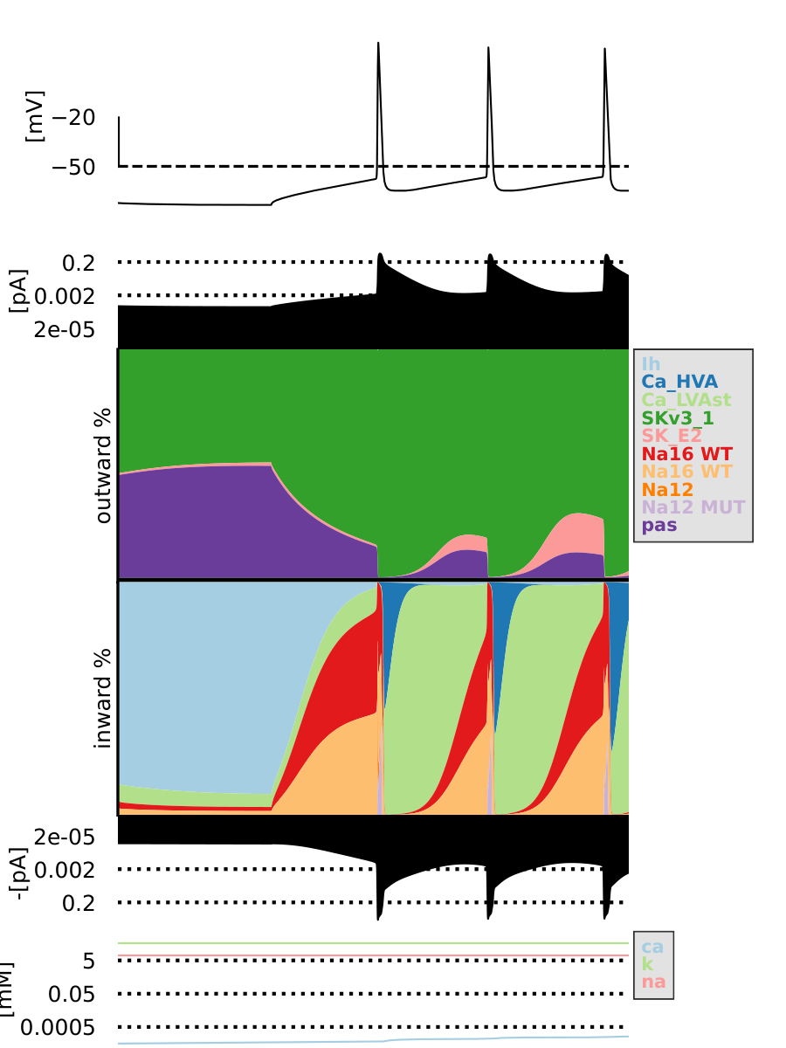

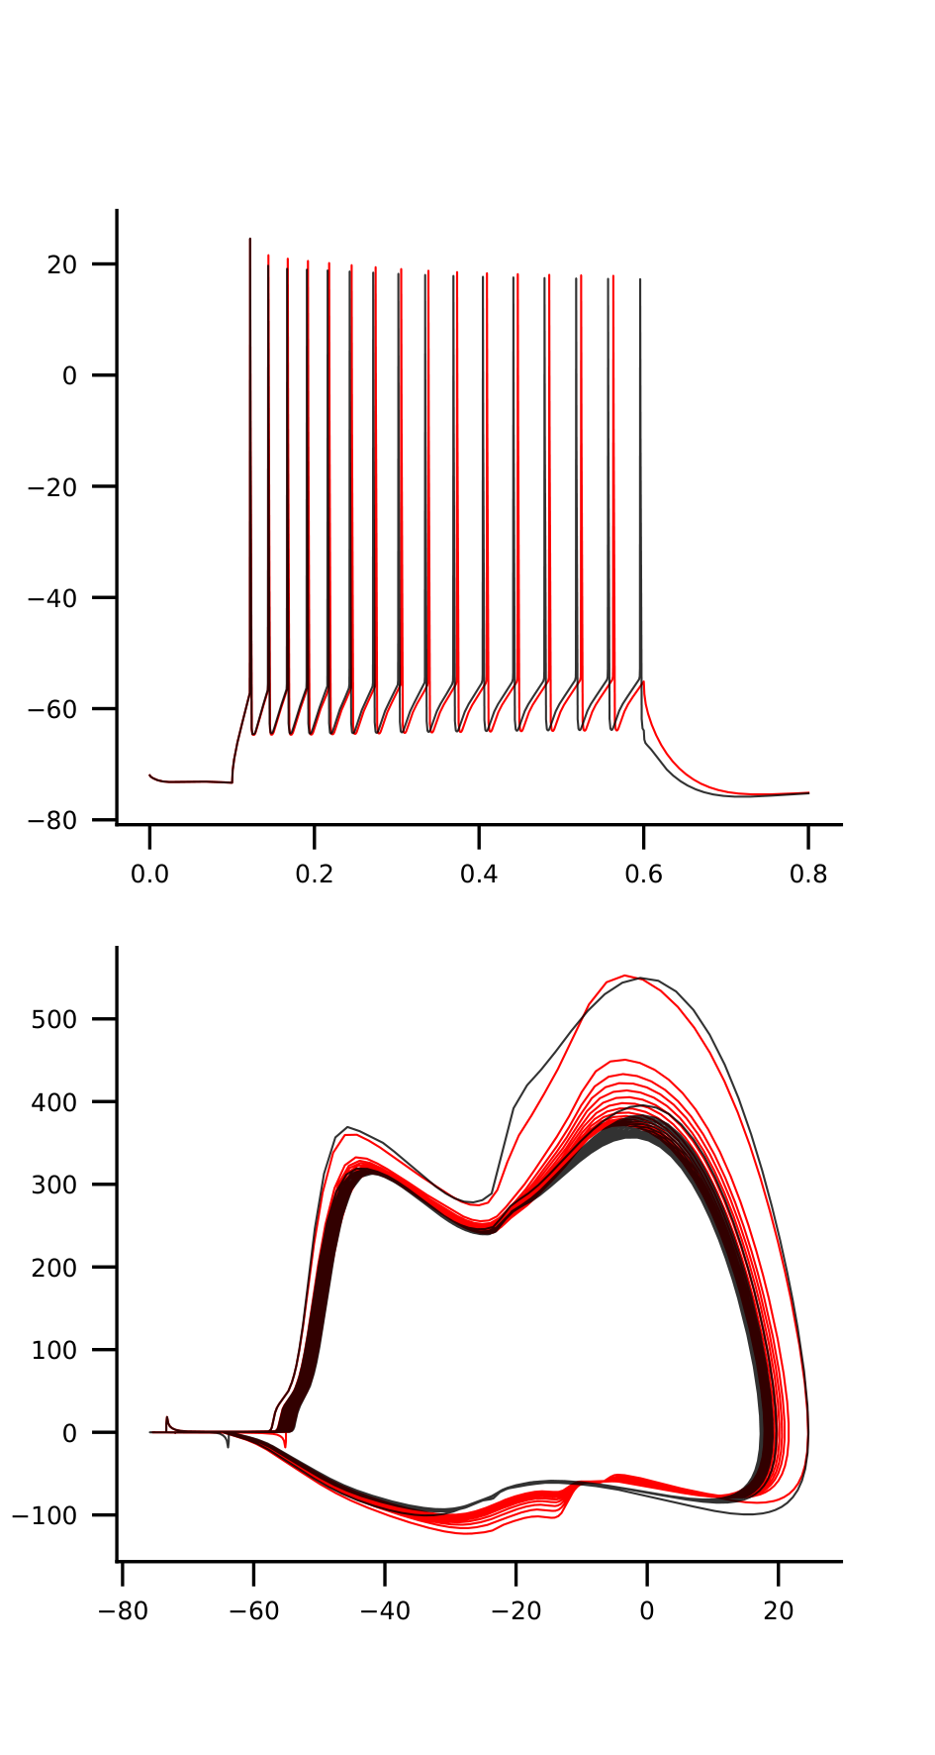
mut1_1_na12-1.0_na16-1.5

Slide 14

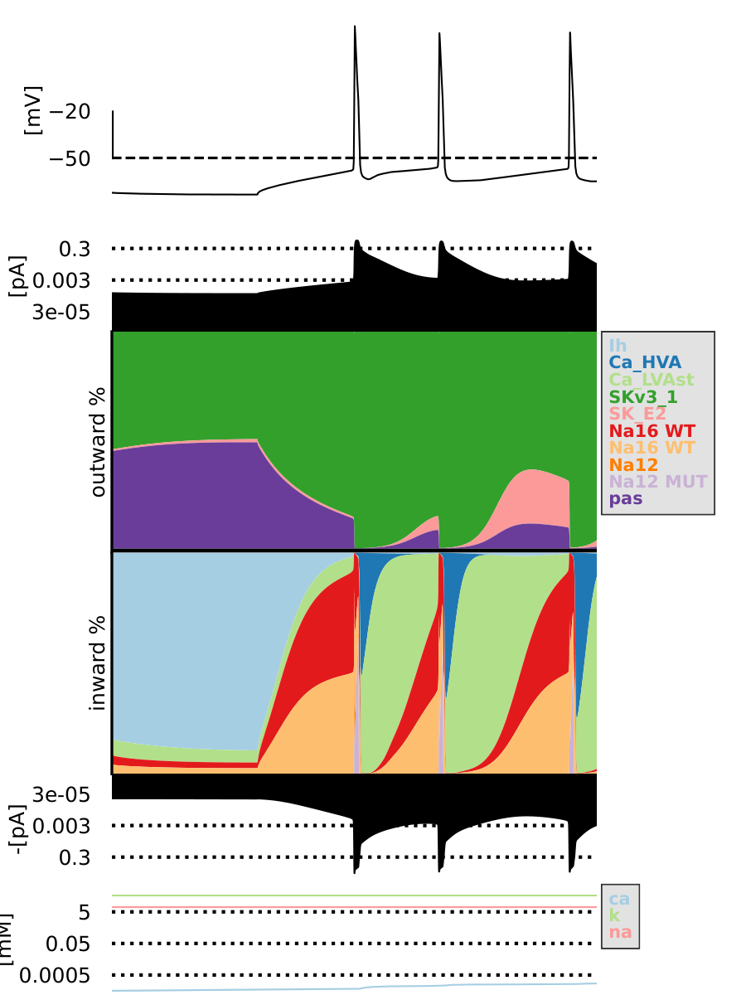

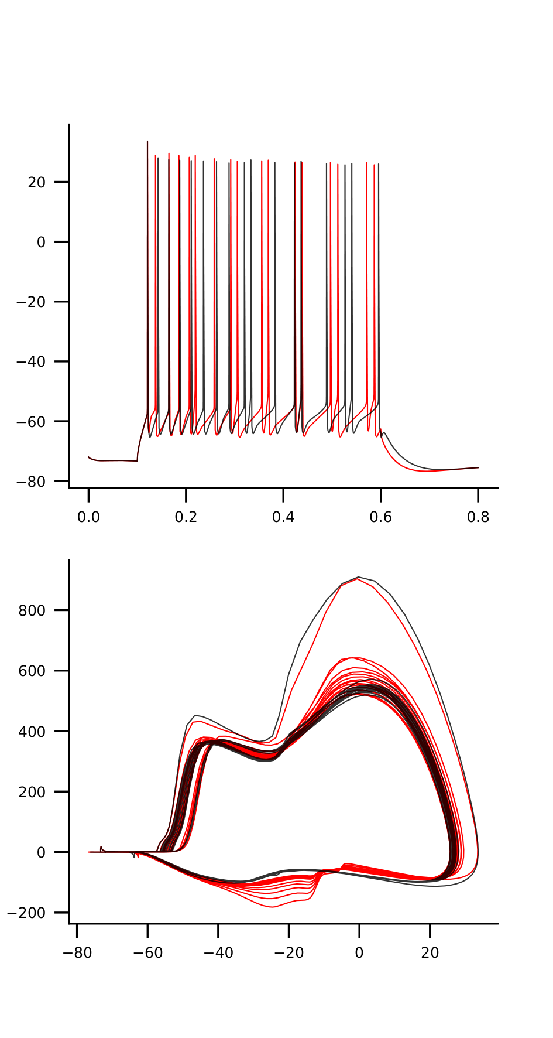
mut1_1_na12-2.25_na16-2.25

Slide 15
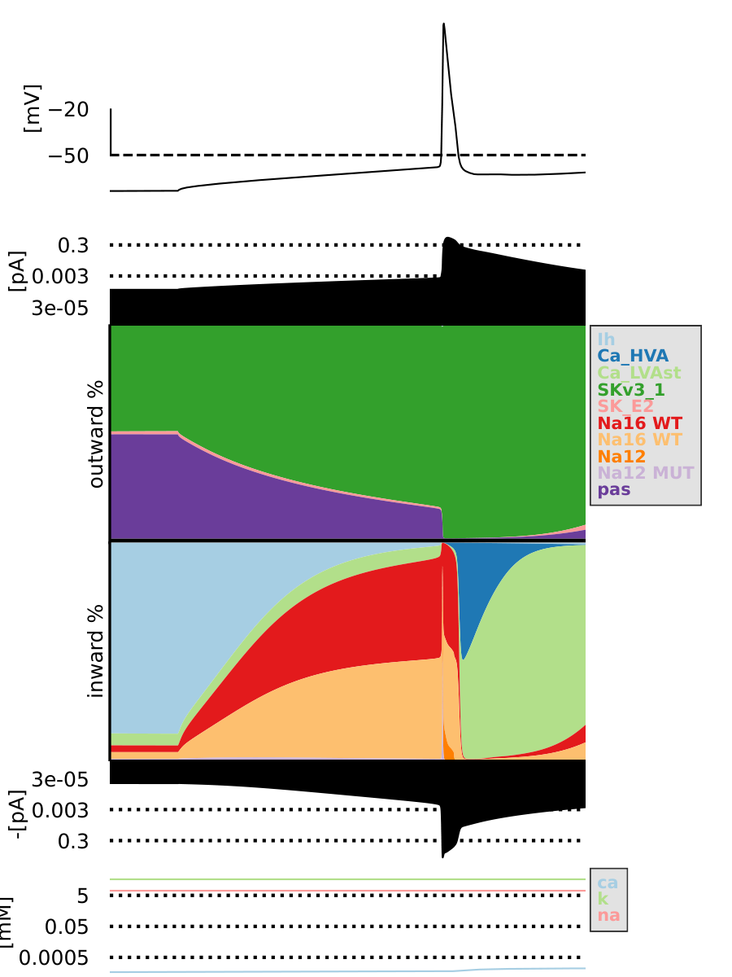
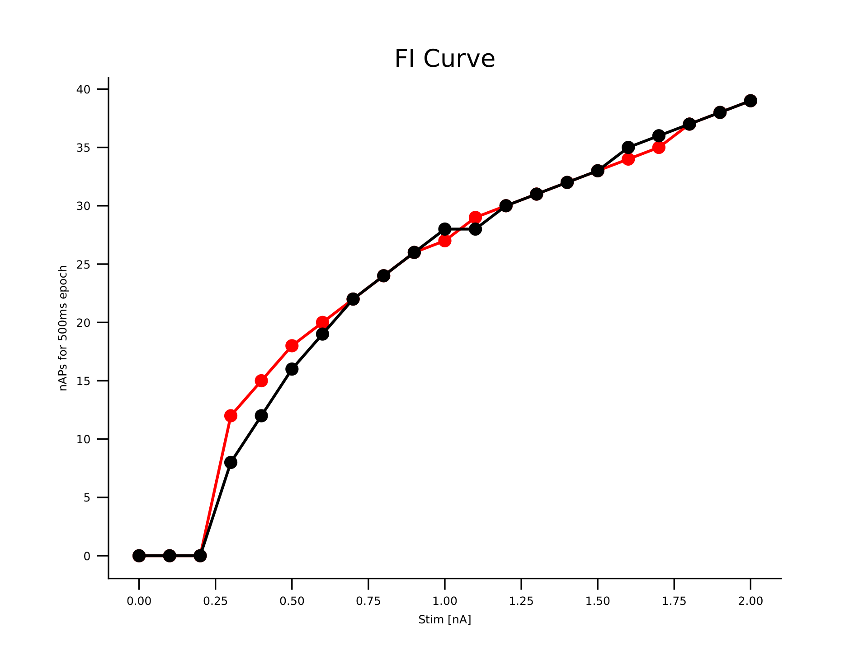
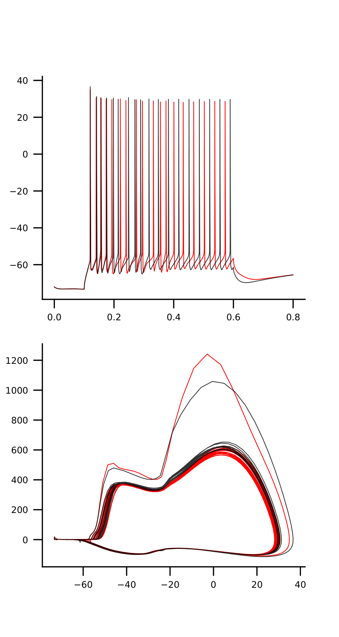
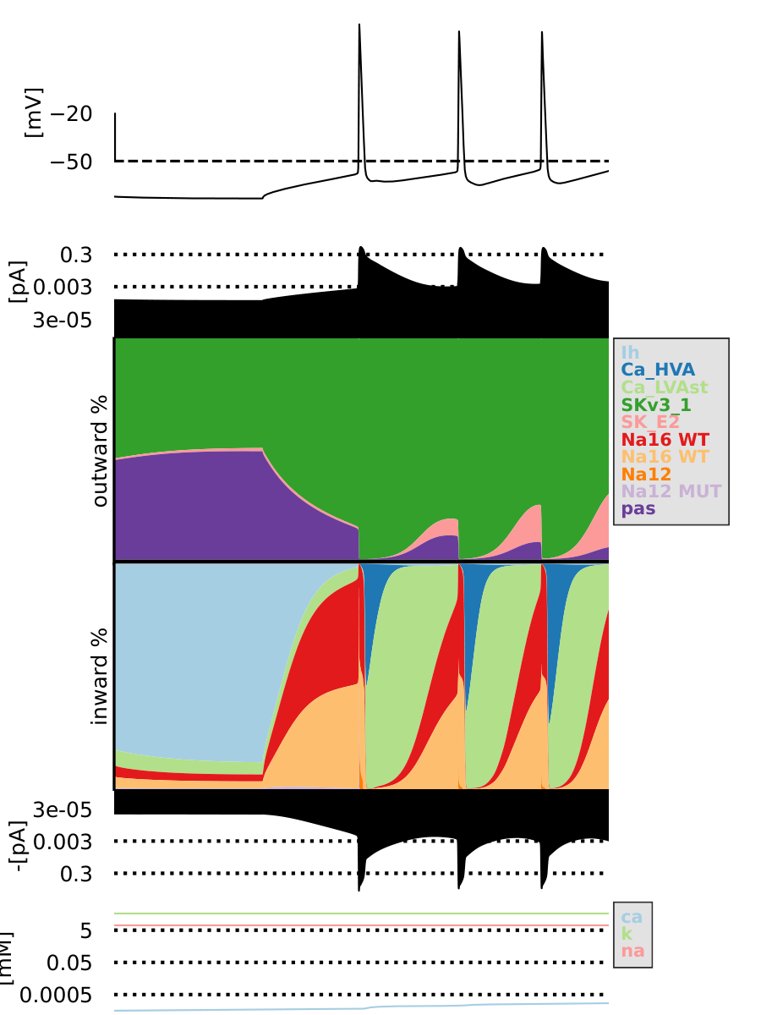
mut2_2_na12-2.75_na16-2.75

Slide 16

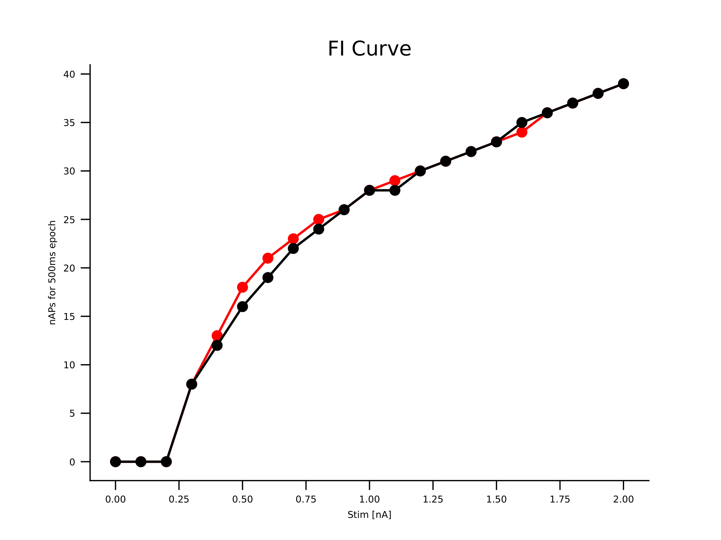
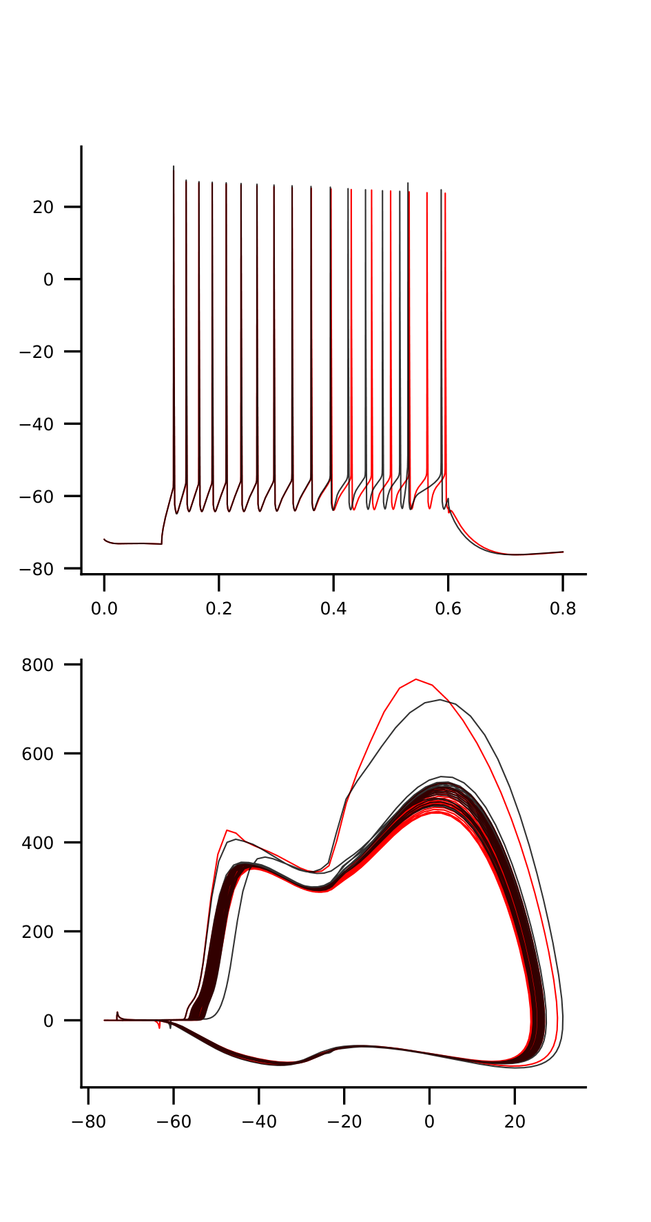

mut2_2_na12-1.25_na16-2.25

Slide 17




mut2_2_na12-1.0_na16-2.0

Slide 18




mut2_2_na12-1.0_na16-1.75

Slide 19




mut2_2_na12-2.0_na16-0.5

Slide 20




mut2_2_na12-2.0_na16-2.5

Slide 21




mut1_1_na12-1.75_na16-3.0

Slide 22




mut1_1_na12-1.75_na16-1.25

Slide 23




mut2_2_na12-3.0_na16-2.25

Slide 24




mut1_1_na12-1.5_na16-2.0

Slide 25




mut2_2_na12-1.75_na16-2.0

Slide 26




mut1_1_na12-1.5_na16-2.25

Slide 27




mut2_2_na12-1.5_na16-2.75

Slide 28




mut2_2_na12-2.25_na16-1.75

Slide 29




mut1_1_na12-3.0_na16-0.5

Slide 30




mut2_2_na12-0.75_na16-1.25

Slide 31



mut2_2_na12-0.5_na16-1.25

Slide 32




mut2_2_na12-3.0_na16-2.0

Slide 33




mut2_2_na12-2.5_na16-2.0

Slide 34




mut1_1_na12-2.25_na16-0.5

Slide 35



mut2_2_na12-1.25_na16-1.75

Slide 36




mut2_2_na12-1.5_na16-1.0

Slide 37




mut2_2_na12-1.5_na16-2.0

Slide 38




mut1_1_na12-3.0_na16-1.5

Slide 39




mut1_1_na12-0.5_na16-1.0

Slide 40




mut1_1_na12-3.0_na16-2.5

Slide 41




mut1_1_na12-2.5_na16-0.5

Slide 42




mut1_1_na12-0.5_na16-2.25

Slide 43




mut2_2_na12-2.5_na16-1.25

Slide 44




mut1_1_na12-2.25_na16-1.5

Slide 45




mut2_2_na12-1.0_na16-0.5

Slide 46




mut2_2_na12-3.0_na16-2.75

Slide 47




mut2_2_na12-2.25_na16-0.75

Slide 48




mut2_2_na12-2.5_na16-0.75

Slide 49




mut2_2_na12-1.75_na16-3.0

Slide 50




mut1_1_na12-2.25_na16-1.25

Slide 51



mut1_1_na12-2.5_na16-1.25

Slide 52




mut1_1_na12-1.25_na16-1.0

Slide 53




mut2_2_na12-2.5_na16-2.75

Slide 54




mut2_2_na12-2.25_na16-1.5

Slide 55




mut2_2_na12-0.75_na16-2.0

Slide 56




mut2_2_na12-1.5_na16-1.5

Slide 57



mut2_2_na12-2.75_na16-3.0

Slide 58




mut1_1_na12-1.5_na16-1.0

Slide 59




mut1_1_na12-2.25_na16-3.0

Slide 60




mut1_1_na12-1.0_na16-2.0

Slide 61



mut2_2_na12-0.5_na16-1.75

Slide 62




mut1_1_na12-2.75_na16-1.0

Slide 63




mut2_2_na12-1.75_na16-2.5

Slide 64




mut1_1_na12-1.0_na16-3.0

Slide 65




mut1_1_na12-1.0_na16-0.75

Slide 66




mut1_1_na12-0.5_na16-2.0

Slide 67




mut2_2_na12-1.0_na16-2.5

Slide 68




mut1_1_na12-1.75_na16-0.5

Slide 69




mut1_1_na12-2.75_na16-1.25

Slide 70



mut2_2_na12-2.25_na16-1.0

Slide 71




mut2_2_na12-0.5_na16-0.5

Slide 72




mut1_1_na12-1.75_na16-1.0

Slide 73



mut2_2_na12-2.0_na16-1.5

Slide 74




mut2_2_na12-2.75_na16-2.25

Slide 75




mut1_1_na12-1.5_na16-2.75

Slide 76



mut2_2_na12-0.75_na16-1.5

Slide 77




mut1_1_na12-2.25_na16-2.75

Slide 78




mut1_1_na12-1.75_na16-1.75

Slide 79




mut1_1_na12-2.5_na16-2.75

Slide 80




mut1_1_na12-2.5_na16-2.25

Slide 81




mut1_1_na12-2.0_na16-2.0

Slide 82




mut2_2_na12-1.0_na16-3.0

Slide 83




mut1_1_na12-2.0_na16-1.0

Slide 84




mut2_2_na12-2.75_na16-0.5

Slide 85



mut2_2_na12-2.25_na16-1.25

Slide 86




mut1_1_na12-2.0_na16-3.0

Slide 87




mut1_1_na12-1.0_na16-0.5

Slide 88



mut2_2_na12-2.75_na16-1.0

Slide 89




mut2_2_na12-1.5_na16-2.25

Slide 90




mut2_2_na12-2.25_na16-2.0

Slide 91




mut1_1_na12-1.25_na16-3.0

Slide 92




mut2_2_na12-2.25_na16-3.0

Slide 93




mut1_1_na12-1.0_na16-1.25

Slide 94




mut1_1_na12-1.5_na16-1.75

Slide 95




mut1_1_na12-2.25_na16-1.0

Slide 96




mut1_1_na12-1.5_na16-1.5

Slide 97




mut1_1_na12-0.5_na16-0.5

Slide 98




mut2_2_na12-1.5_na16-0.5

Slide 99



mut2_2_na12-2.0_na16-1.75

Slide 100




mut1_1_na12-2.25_na16-1.75

Slide 101




mut1_1_na12-2.75_na16-0.5

Slide 102




mut1_1_na12-2.5_na16-2.0

Slide 103




mut1_1_na12-1.75_na16-0.75

Slide 104




mut2_2_na12-1.75_na16-0.75

Slide 105




mut1_1_na12-2.75_na16-3.0

Slide 106



mut2_2_na12-2.5_na16-1.5

Slide 107



mut2_2_na12-1.5_na16-1.25

Slide 108




mut1_1_na12-0.75_na16-1.0

Slide 109




mut1_1_na12-2.0_na16-2.75

Slide 110




mut1_1_na12-0.5_na16-1.75

Slide 111




mut1_1_na12-0.75_na16-1.5

Slide 112




mut2_2_na12-0.75_na16-2.75

Slide 113



mut2_2_na12-1.5_na16-1.75

Slide 114




mut2_2_na12-1.0_na16-1.0

Slide 115




mut1_1_na12-3.0_na16-2.0

Slide 116




mut2_2_na12-1.25_na16-3.0

Slide 117




mut1_1_na12-2.0_na16-1.75

Slide 118



mut2_2_na12-3.0_na16-1.75

Slide 119




mut2_2_na12-2.25_na16-2.5

Slide 120




mut1_1_na12-1.5_na16-3.0

Slide 121




mut1_1_na12-0.75_na16-2.0

Slide 122




mut1_1_na12-3.0_na16-1.0

Slide 123




mut2_2_na12-0.5_na16-0.75

Slide 124




mut2_2_na12-2.5_na16-2.25

Slide 125



mut2_2_na12-0.75_na16-1.75

Slide 126



mut2_2_na12-2.0_na16-3.0

Slide 127




mut1_1_na12-1.0_na16-1.75

Slide 128




mut1_1_na12-2.75_na16-2.75

Slide 129




mut1_1_na12-0.75_na16-1.25

Slide 130




mut2_2_na12-2.0_na16-2.75

Slide 131




mut2_2_na12-1.25_na16-1.0

Slide 132




mut1_1_na12-1.5_na16-1.25

Slide 133




mut2_2_na12-0.5_na16-2.0

Slide 134




mut1_1_na12-1.25_na16-0.5

Slide 135




mut2_2_na12-1.25_na16-0.5

Slide 136




mut1_1_na12-2.5_na16-1.75

Slide 137



mut2_2_na12-2.0_na16-0.75

Slide 138



mut2_2_na12-0.75_na16-3.0

Slide 139



mut2_2_na12-1.75_na16-1.5

Slide 140



mut2_2_na12-1.75_na16-1.75

Slide 141




mut1_1_na12-0.75_na16-3.0

Slide 142




mut2_2_na12-2.75_na16-2.5

Slide 143




mut1_1_na12-1.75_na16-1.5

Slide 144




mut2_2_na12-2.75_na16-0.75

Slide 145



mut2_2_na12-1.0_na16-1.25

Slide 146




mut1_1_na12-1.5_na16-0.75

Slide 147




mut2_2_na12-1.25_na16-0.75

Slide 148




mut1_1_na12-1.5_na16-2.5

Slide 149



mut2_2_na12-0.5_na16-2.5

Slide 150



mut2_2_na12-1.75_na16-1.0

Slide 151




mut1_1_na12-1.0_na16-2.75

Slide 152



mut2_2_na12-0.5_na16-2.75

Slide 153




mut2_2_na12-2.25_na16-2.25

Slide 154




mut2_2_na12-0.75_na16-1.0

Slide 155



mut2_2_na12-1.25_na16-1.25

Slide 156




mut1_1_na12-2.25_na16-2.5

Slide 157




mut1_1_na12-2.0_na16-1.25

Slide 158




mut2_2_na12-2.5_na16-0.5

Slide 159




mut1_1_na12-2.0_na16-0.5

Slide 160




mut1_1_na12-3.0_na16-2.75

Slide 161



mut2_2_na12-0.5_na16-1.0

Slide 162




mut1_1_na12-1.75_na16-2.0

Slide 163



mut2_2_na12-3.0_na16-1.5

Slide 164




mut1_1_na12-2.0_na16-2.25

Slide 165




mut1_1_na12-1.75_na16-2.25

Slide 166




mut1_1_na12-0.5_na16-3.0

Slide 167




mut1_1_na12-1.25_na16-1.75

Slide 168




mut1_1_na12-2.5_na16-0.75

Slide 169




mut2_2_na12-2.0_na16-1.25

Slide 170




mut2_2_na12-1.25_na16-2.75

Slide 171




mut1_1_na12-0.5_na16-2.75

Slide 172



mut2_2_na12-1.25_na16-1.5

Slide 173




mut1_1_na12-0.5_na16-1.25

Slide 174




mut1_1_na12-0.75_na16-2.75

Slide 175



mut2_2_na12-0.75_na16-0.75

Slide 176




mut2_2_na12-3.0_na16-2.5

Slide 177




mut2_2_na12-2.75_na16-1.25

Slide 178




mut2_2_na12-1.75_na16-2.25

Slide 179



mut2_2_na12-1.25_na16-2.5

Slide 180




mut1_1_na12-0.75_na16-2.5

Slide 181




mut1_1_na12-1.0_na16-1.0

Slide 182




mut1_1_na12-2.0_na16-0.75

Slide 183




mut1_1_na12-2.75_na16-1.5

Slide 184




mut2_2_na12-2.75_na16-2.0

Slide 185




mut2_2_na12-0.75_na16-2.5

Slide 186



mut2_2_na12-1.75_na16-2.75

Slide 187




mut2_2_na12-1.5_na16-3.0

Slide 188




mut2_2_na12-1.25_na16-2.0

Slide 189



mut2_2_na12-2.75_na16-1.75

Slide 190




mut1_1_na12-2.25_na16-0.75

Slide 191




mut2_2_na12-3.0_na16-0.5

Slide 192




mut1_1_na12-2.75_na16-2.0

Slide 193




mut2_2_na12-1.5_na16-0.75

Slide 194




mut1_1_na12-0.75_na16-0.5

Slide 195



mut2_2_na12-3.0_na16-3.0

Slide 196




mut1_1_na12-2.5_na16-3.0

Slide 197




mut1_1_na12-3.0_na16-1.25

Slide 198




mut1_1_na12-3.0_na16-2.25

Slide 199




mut2_2_na12-0.5_na16-3.0

Slide 200




mut1_1_na12-2.75_na16-2.5

Slide 201




mut1_1_na12-1.25_na16-2.5

Slide 202




mut1_1_na12-1.75_na16-2.5

Slide 203



mut2_2_na12-2.75_na16-1.5

Slide 204




mut1_1_na12-1.0_na16-2.25

Slide 205




mut1_1_na12-3.0_na16-1.75

Slide 206



mut2_2_na12-2.5_na16-1.75

Slide 207




mut1_1_na12-0.75_na16-0.75

Slide 208




mut1_1_na12-0.5_na16-0.75

Slide 209



mut2_2_na12-3.0_na16-1.0

Slide 210



mut2_2_na12-3.0_na16-1.25

Slide 211




mut2_2_na12-2.0_na16-2.0

Slide 212




mut1_1_na12-1.25_na16-0.75

Slide 213




mut1_1_na12-0.75_na16-2.25

Slide 214




mut2_2_na12-3.0_na16-0.75

Slide 215




mut2_2_na12-2.0_na16-2.25

Slide 216



mut2_2_na12-1.0_na16-2.75

Slide 217




mut1_1_na12-2.5_na16-1.0

Slide 218




mut2_2_na12-0.5_na16-2.25

Slide 219



mut2_2_na12-2.25_na16-2.75

Slide 220




mut1_1_na12-1.25_na16-2.25

Slide 221




mut1_1_na12-0.5_na16-1.5

Slide 222




mut1_1_na12-1.5_na16-0.5

Slide 223




mut1_1_na12-1.25_na16-2.0

Slide 224



mut2_2_na12-0.5_na16-1.5

Slide 225




mut2_2_na12-0.75_na16-0.5

Slide 226



mut2_2_na12-1.0_na16-0.75

Slide 227




mut1_1_na12-3.0_na16-0.75

Slide 228




mut2_2_na12-2.25_na16-0.5

Slide 229




mut1_1_na12-2.75_na16-0.75

Slide 230



mut2_2_na12-1.0_na16-1.5

Slide 231




mut1_1_na12-2.0_na16-2.5

Slide 232




mut1_1_na12-0.75_na16-1.75

Slide 233




mut2_2_na12-0.75_na16-2.25

Slide 234




mut1_1_na12-0.5_na16-2.5

Slide 235



mut2_2_na12-2.0_na16-1.0

Slide 236



mut1_1_na12-2.5_na16-1.5

Slide 237




mut1_1_na12-1.25_na16-1.5

Slide 238




mut1_1_na12-2.75_na16-1.75

Slide 239




mut2_2_na12-1.0_na16-2.25

Slide 240



mut2_2_na12-1.5_na16-2.5

Slide 241




mut1_1_na12-2.25_na16-2.0

Slide 242




mut1_1_na12-2.5_na16-2.5

Slide 243




mut2_2_na12-2.5_na16-2.5

